Slide 1
LibICE-post: User guide
Post-processing of experimental and numerical data for ICE applications
Federico Ramognino

Slide 2



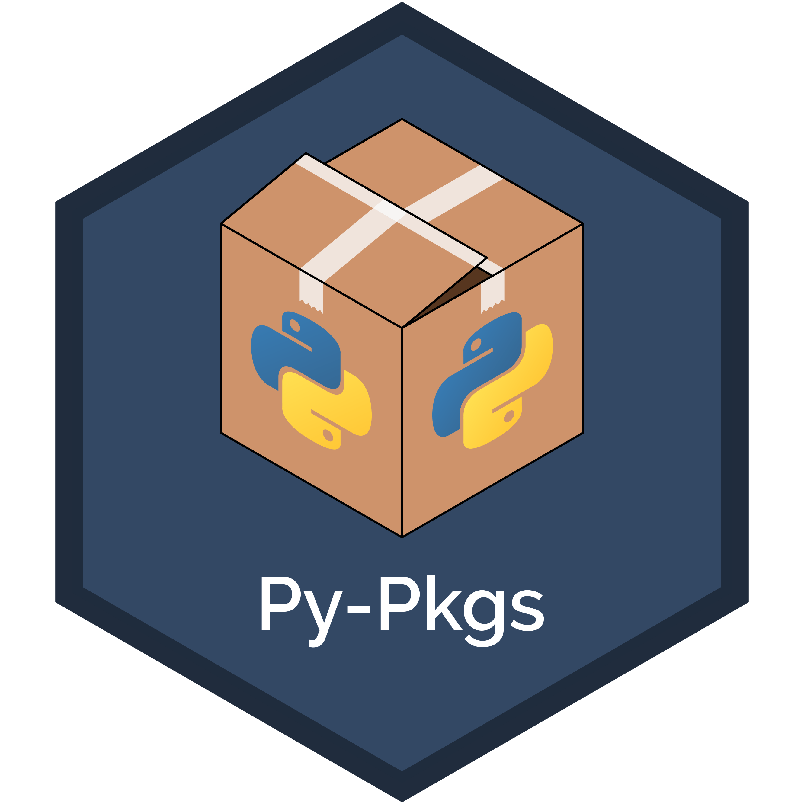
Why libICEpost…?
No common methodology was present for processing of results (experimental or CFD simulations), leading to:
Redundancy and duplication of code
Multiple codes and software
Risk of errors
Loss of efficiency and knowledge
Need for a standardized framework to be shared within the research group
Organizing all methodologies in a single python package
…why python?
Free (no licence required)
Strong community (many packages available)
Easy to use
Versatile
Not OS-dependent

Slide 3
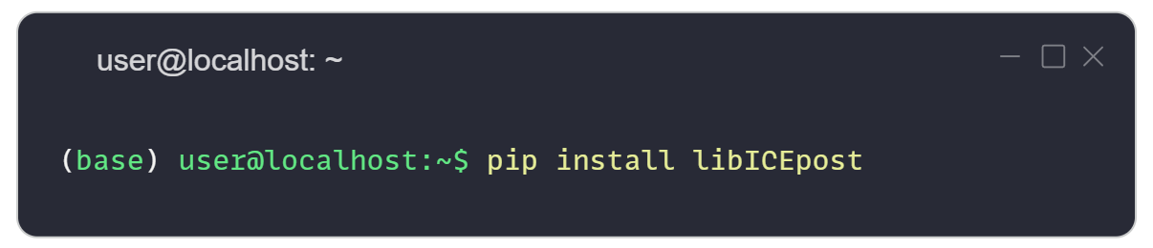


What is inside libICEpost
Scope of the package:
Implementation methodologies for pre/post-processing of data from internal combustion engines applications
Main features:
Modeling of mixtures, with their thermodynamic properties
Modeling of internal combustion engines for processing heat release rate and heat transfer from pressure traces
Input/output interfaces for processing OpenFOAM results
Requirements: python>=3.11
PyPI: https://pypi.org/project/libICEpost/
GitHub: https://github.com/RamogninoF/LibICE-post

Slide 4

Structure of the package
Three main subpackages:
📦 libICEpost
├─ 📁 src
│ ├─ 📁 base
│ ├─ 📁 thermophysicalModels
│ ├─ 📁 engineModel
│ ├─ ...
│ └─ 📁 __init__.py
├─ 📁 scripts
├─ 📁 Database
└─ 📁 __init__.py

Slide 5
Structure of the package
Three main subpackages:
src – Core of the library, contains all functions and classes. Major groups are:
base – generic-use classes and functions
thermophysicalModels – modeling of chemistry and thermophysical properties of mixtures
engineModel – models for description of ICE
📦 libICEpost
├─ 📁 src
│ ├─ 📁 base
│ ├─ 📁 thermophysicalModels
│ ├─ 📁 engineModel
│ ├─ ...
│ └─ 📁 __init__.py
├─ 📁 scripts
├─ 📁 Database
└─ 📁 __init__.py

Slide 6
Structure of the package
Three main subpackages:
src – Core of the library, contains all functions and classes. Major groups are:
base – generic-use classes and functions
thermophysicalModels – modeling of chemistry and thermophysical properties of mixtures
engineModel – models for description of ICE
scripts – Contains executable scripts, where automated workflows can be implemented
📦 libICEpost
├─ 📁 src
│ ├─ 📁 base
│ ├─ 📁 thermophysicalModels
│ ├─ 📁 engineModel
│ ├─ ...
│ └─ 📁 __init__.py
├─ 📁 scripts
├─ 📁 Database
└─ 📁 __init__.py

Slide 7
Structure of the package
Three main subpackages:
src – Core of the library, contains all functions and classes. Major groups are:
base – generic-use classes and functions
thermophysicalModels – modeling of chemistry and thermophysical properties of mixtures
engineModel – models for description of ICE
scripts – Contains executable scripts, where automated workflows can be implemented
Database – A built-in database with useful data (periodic table, molecules, fuels, thermophysical properties, etc.)
📦 libICEpost
├─ 📁 src
│ ├─ 📁 base
│ ├─ 📁 thermophysicalModels
│ ├─ 📁 engineModel
│ ├─ ...
│ └─ 📁 __init__.py
├─ 📁 scripts
├─ 📁 Database
└─ 📁 __init__.py

Slide 8
libICEpost.src.base
Generic-use classes (data-structures, signal filters, etc.) and functions (I/O, OpenFOAM interfaces, etc.)
📦 libICEpost
├─ 📁 src
│ ├─ 📁 base
│ │ ├─ 📁 dataStructures
│ │ ├─ 📁 Functions
│ │ ├─ 📁 BaseClass.py
│ │ └─ ...
│ └─ ...
└─ ...

Slide 9
Input/Output and run-time selection
Generic-use classes (data-structures, signal filters, etc.) and functions (I/O, OpenFOAM interfaces, etc.)
Implementation of I/O and run-time selection of models following OpenFOAM rationale
📦 libICEpost
├─ 📁 src
│ ├─ 📁 base
│ │ ├─ 📁 dataStructures
│ │ │ ├─ 📁 Dictionary.py
│ │ │ └─ ...
│ │ ├─ 📁 Functions
│ │ ├─ 📁 BaseClass.py
│ │ └─ ...
│ └─ ...
└─ ...
Input
Base.selector(“ChildB”, {...})
Base
🔧selector(typeName, dictionary)
selectionTable
“ChildA” -> ChildA(Base)
“ChildB” -> ChildB(Base)
...
ChildA(Base)
🔧fromDictionary(dictionary)
ChildB(Base)
🔧fromDictionary(dictionary)
Output
ChildB.fromDictionary({...})

Slide 10
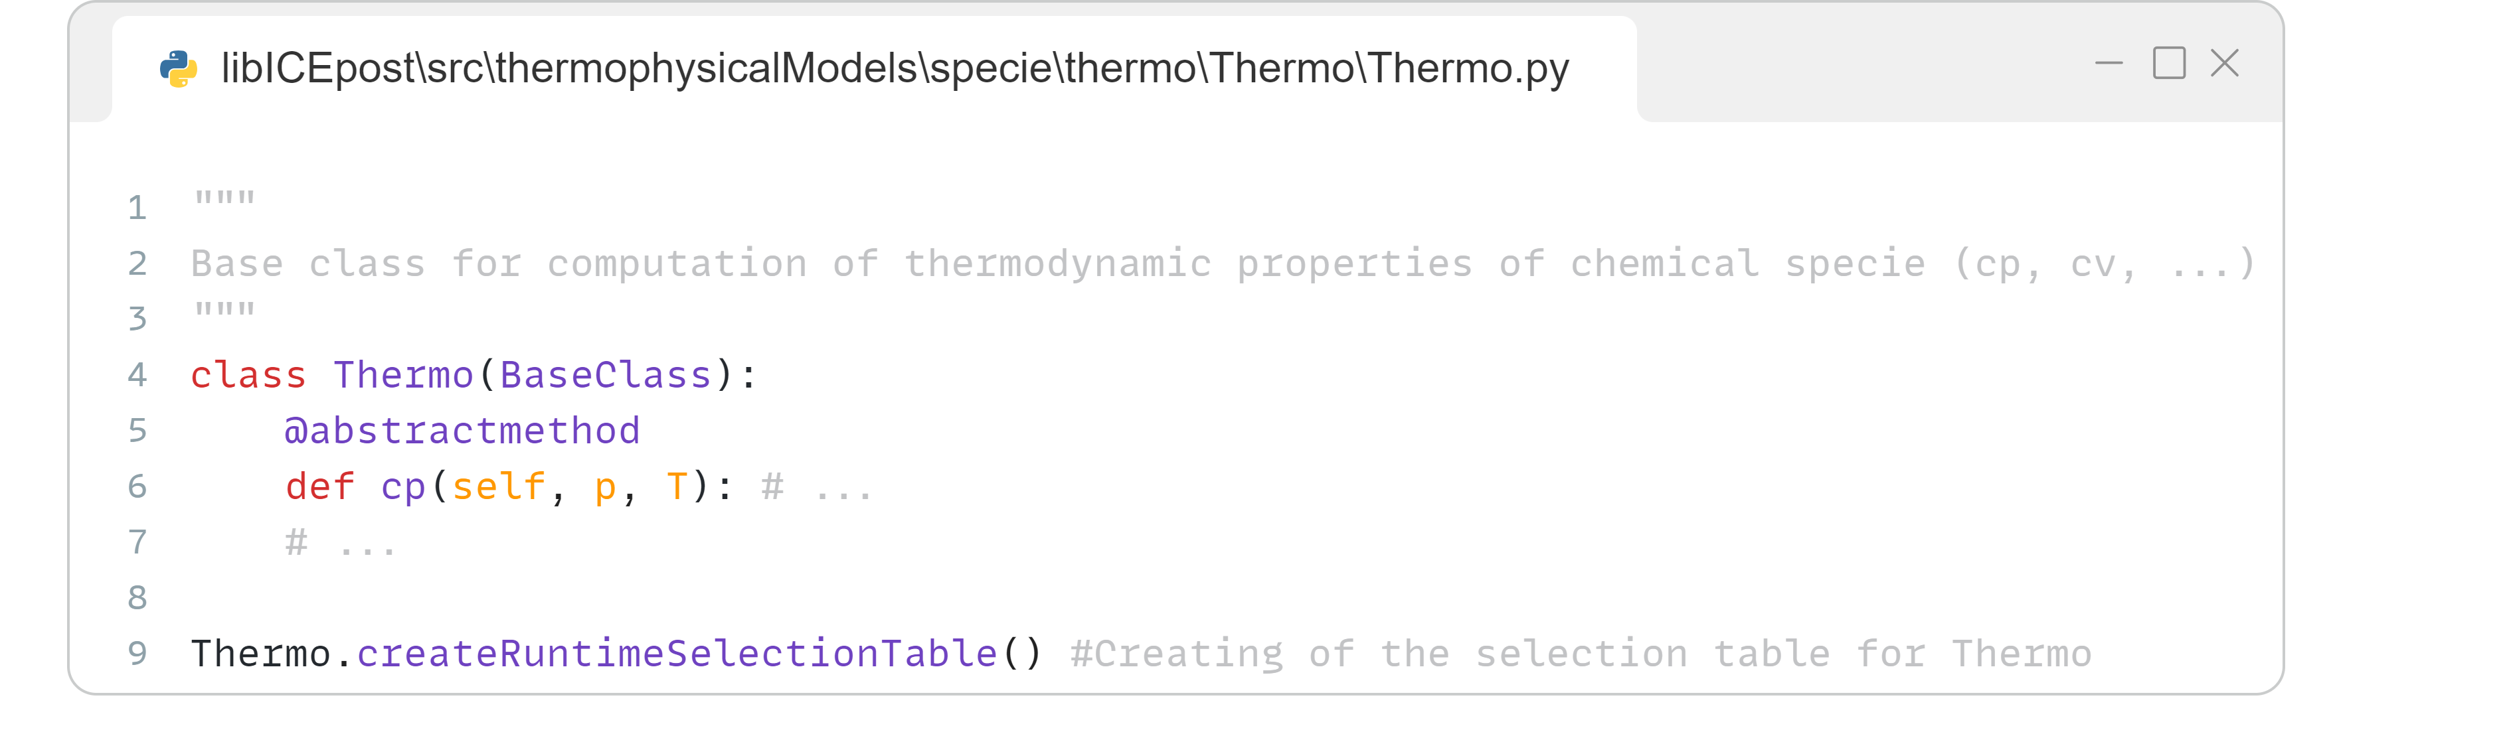
Run-time selection – BaseClass
BaseClass – Virtual Base Class with implementation of run-time selection for handling model choice
Used to give abstract-base-class functionalities to classes defining the structure of models
📦 libICEpost
├─ 📁 src
│ ├─ 📁 base
│ │ ├─ 📁 dataStructures
│ │ │ ├─ 📁 Dictionary.py
│ │ │ └─ ...
│ │ ├─ 📁 Functions
│ │ ├─ 📁 BaseClass.py
│ │ └─ ...
│ └─ ...
└─ ...
Abstract class defining the structure of the model inheriting from BaseClass
🧰 BaseClass(metaclass=abc.ABCMeta)
├─ 🔧 createRuntimeSelectionTable(...)
├─ 🔧 addToRuntimeSelectionTable (...)
├─ 🔧 fromDictionary(...)
├─ 🔧 selector(...)
└─ ...
LibICE-post/templates/inheritance

Slide 11
Run-time selection – BaseClass
BaseClass – Virtual Base Class with implementation of run-time selection for handling model choice
Used to give abstract-base-class functionalities to classes defining the structure of models
📦 libICEpost
├─ 📁 src
│ ├─ 📁 base
│ │ ├─ 📁 dataStructures
│ │ │ ├─ 📁 Dictionary.py
│ │ │ └─ ...
│ │ ├─ 📁 Functions
│ │ ├─ 📁 BaseClass.py
│ │ └─ ...
│ └─ ...
└─ ...
🧰 BaseClass(metaclass=abc.ABCMeta)
├─ 🔧 createRuntimeSelectionTable(...)
├─ 🔧 addToRuntimeSelectionTable (...)
├─ 🔧 fromDictionary(...)
├─ 🔧 selector(...)
└─ ...
Virtual methods to be overwritten in child classes
LibICE-post/templates/inheritance

Slide 12
Run-time selection – BaseClass
BaseClass – Virtual Base Class with implementation of run-time selection for handling model choice
Used to give abstract-base-class functionalities to classes defining the structure of models
Creation of selection-table for the VBC defining the common structure of the specific model
📦 libICEpost
├─ 📁 src
│ ├─ 📁 base
│ │ ├─ 📁 dataStructures
│ │ │ ├─ 📁 Dictionary.py
│ │ │ └─ ...
│ │ ├─ 📁 Functions
│ │ ├─ 📁 BaseClass.py
│ │ └─ ...
│ └─ ...
└─ ...
🧰 BaseClass(metaclass=abc.ABCMeta)
├─ 🔧 createRuntimeSelectionTable(...)
├─ 🔧 addToRuntimeSelectionTable (...)
├─ 🔧 fromDictionary(...)
├─ 🔧 selector(...)
└─ ...
Creation of the selection table for class Thermo
LibICE-post/templates/inheritance

Slide 13
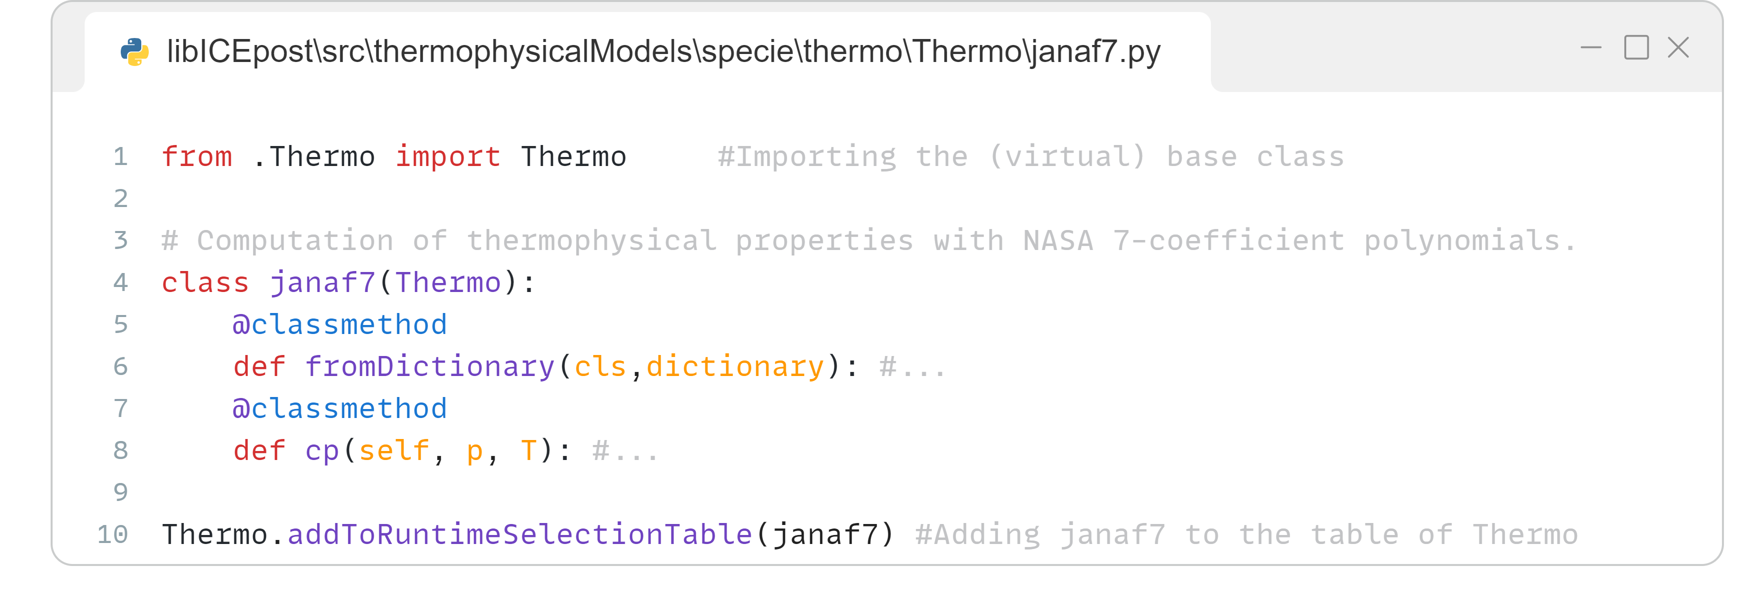
Run-time selection – BaseClass
BaseClass – Virtual Base Class with implementation of run-time selection for handling model choice
Used to give abstract-base-class functionalities to classes defining the structure of models
Creation of selection-table for the VBC defining the common structure of the specific model
Deriving concrete child classes from the VBC with the desired model implementation, adding them to its selection table
📦 libICEpost
├─ 📁 src
│ ├─ 📁 base
│ │ ├─ 📁 dataStructures
│ │ │ ├─ 📁 Dictionary.py
│ │ │ └─ ...
│ │ ├─ 📁 Functions
│ │ ├─ 📁 BaseClass.py
│ │ └─ ...
│ └─ ...
└─ ...
🧰 BaseClass(metaclass=abc.ABCMeta)
├─ 🔧 createRuntimeSelectionTable(...)
├─ 🔧 addToRuntimeSelectionTable (...)
├─ 🔧 fromDictionary(...)
├─ 🔧 selector(...)
└─ ...
Inheriting from abstract class Thermo
LibICE-post/templates/inheritance

Slide 14
Run-time selection – BaseClass
BaseClass – Virtual Base Class with implementation of run-time selection for handling model choice
Used to give abstract-base-class functionalities to classes defining the structure of models
Creation of selection-table for the VBC defining the common structure of the specific model
Deriving concrete child classes from the VBC with the desired model implementation, adding them to its selection table
📦 libICEpost
├─ 📁 src
│ ├─ 📁 base
│ │ ├─ 📁 dataStructures
│ │ │ ├─ 📁 Dictionary.py
│ │ │ └─ ...
│ │ ├─ 📁 Functions
│ │ ├─ 📁 BaseClass.py
│ │ └─ ...
│ └─ ...
└─ ...
🧰 BaseClass(metaclass=abc.ABCMeta)
├─ 🔧 createRuntimeSelectionTable(...)
├─ 🔧 addToRuntimeSelectionTable (...)
├─ 🔧 fromDictionary(...)
├─ 🔧 selector(...)
└─ ...
Implementation of virtual methods
LibICE-post/templates/inheritance

Slide 15
Run-time selection – BaseClass
BaseClass – Virtual Base Class with implementation of run-time selection for handling model choice
Used to give abstract-base-class functionalities to classes defining the structure of models
Creation of selection-table for the VBC defining the common structure of the specific model
Deriving concrete child classes from the VBC with the desired model implementation, adding them to its selection table
📦 libICEpost
├─ 📁 src
│ ├─ 📁 base
│ │ ├─ 📁 dataStructures
│ │ │ ├─ 📁 Dictionary.py
│ │ │ └─ ...
│ │ ├─ 📁 Functions
│ │ ├─ 📁 BaseClass.py
│ │ └─ ...
│ └─ ...
└─ ...
🧰 BaseClass(metaclass=abc.ABCMeta)
├─ 🔧 createRuntimeSelectionTable(...)
├─ 🔧 addToRuntimeSelectionTable (...)
├─ 🔧 fromDictionary(...)
├─ 🔧 selector(...)
└─ ...
Adding janaf7 to the selection table of Thermo
LibICE-post/templates/inheritance

Slide 16
Run-time selection – BaseClass
BaseClass – Virtual Base Class with implementation of run-time selection for handling model choice
Used to give abstract-base-class functionalities to classes defining the structure of models
Creation of selection-table for the VBC defining the common structure of the specific model
Deriving concrete child classes from the VBC with the desired model implementation, adding them to its selection table
Defining a fromDictionary method, which is used during the run-time selection for construction from a dictionary
📦 libICEpost
├─ 📁 src
│ ├─ 📁 base
│ │ ├─ 📁 dataStructures
│ │ │ ├─ 📁 Dictionary.py
│ │ │ └─ ...
│ │ ├─ 📁 Functions
│ │ ├─ 📁 BaseClass.py
│ │ └─ ...
│ └─ ...
└─ ...
🧰 BaseClass(metaclass=abc.ABCMeta)
├─ 🔧 createRuntimeSelectionTable(...)
├─ 🔧 addToRuntimeSelectionTable (...)
├─ 🔧 fromDictionary(dictionary)
├─ 🔧 selector(...)
└─ ...
Method for construction from a dictionary entry
LibICE-post/templates/inheritance

Slide 17
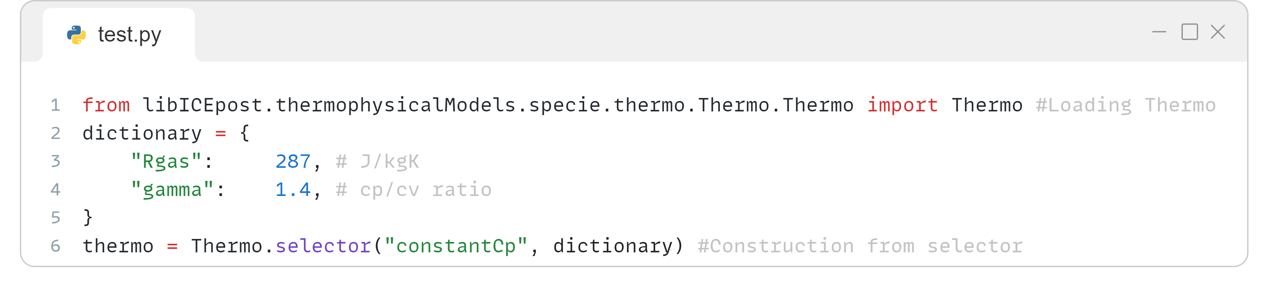
Run-time selection – BaseClass
BaseClass – Virtual Base Class with implementation of run-time selection for handling model choice
Used to give abstract-base-class functionalities to classes defining the structure of models
Creation of selection-table for the VBC defining the common structure of the specific model
Deriving concrete child classes from the VBC with the desired model implementation, adding them to its selection table
Defining a fromDictionary method, which is used during the run-time selection for construction from a dictionary
Selection of the model with a common interface (selector), using the model's name and a dictionary, which is fed to the fromDictionary classmethod of the required child-class
📦 libICEpost
├─ 📁 src
│ ├─ 📁 base
│ │ ├─ 📁 dataStructures
│ │ │ ├─ 📁 Dictionary.py
│ │ │ └─ ...
│ │ ├─ 📁 Functions
│ │ ├─ 📁 BaseClass.py
│ │ └─ ...
│ └─ ...
└─ ...
🧰 BaseClass(metaclass=abc.ABCMeta)
├─ 🔧 createRuntimeSelectionTable(...)
├─ 🔧 addToRuntimeSelectionTable (...)
├─ 🔧 fromDictionary(dictionary)
├─ 🔧 selector(typeName, dictionary)
└─ ...
Construction of constantCp class from dictionary
LibICE-post/templates/inheritance

Slide 18
Run-time selection – BaseClass
BaseClass – Virtual Base Class with implementation of run-time selection for handling model choice
Used to give abstract-base-class functionalities to classes defining the structure of models
Creation of selection-table for the VBC defining the common structure of the specific model
Deriving concrete child classes from the VBC with the desired model implementation, adding them to its selection table
Defining a fromDictionary method, which is used during the run-time selection for construction from a dictionary
Selection of the model with a common interface (selector), using the model's name and a dictionary, which is fed to the fromDictionary classmethod of the required child-class
Template of class inheritance structure can be found in the templates/inheritance/ folder of the GitHub repository
📦 libICEpost
├─ 📁 src
│ ├─ 📁 base
│ │ ├─ 📁 dataStructures
│ │ │ ├─ 📁 Dictionary.py
│ │ │ └─ ...
│ │ ├─ 📁 Functions
│ │ ├─ 📁 BaseClass.py
│ │ └─ ...
│ └─ ...
└─ ...
🗂️ LibICE-post/template
├─ 📁 inheritance
│ ├─ 📁 Base.py
│ ├─ 📁 Child.py
┆ └─ 📁 __init__.py

Slide 19
Input/output – Dictionary
BaseClass – Virtual Base Class with implementation of run-time selection for handling model choice
Dictionary – Ordered dictionary embedding useful I/O and access functionalities
📦 libICEpost
├─ 📁 src
│ ├─ 📁 base
│ │ ├─ 📁 dataStructures
│ │ │ ├─ 📁 Dictionary.py
│ │ │ └─ ...
│ │ ├─ 📁 Functions
│ │ ├─ 📁 BaseClass.py
│ │ └─ ...
│ └─ ...
└─ ...
🧰 Dictionary(collections.OrderedDict)
├─ 🔧 fromFile(fileName)
├─ 🔧 lookup(...)
├─ 🔧 lookupOrDefault(...)
└─ ...

Slide 20
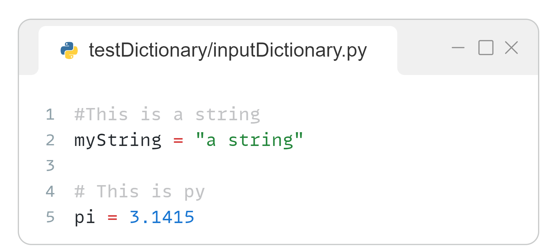
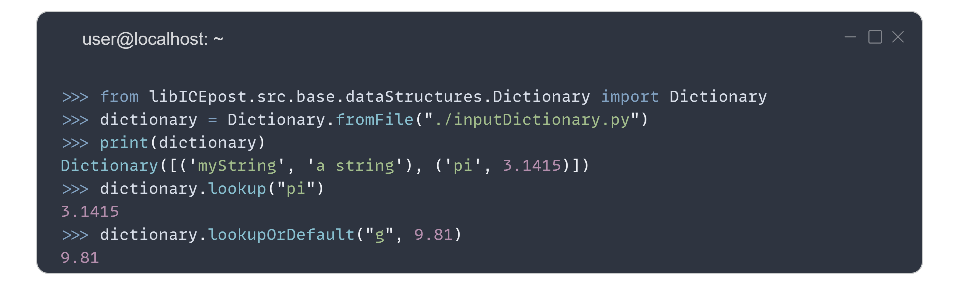
Input/output – Dictionary
BaseClass – Virtual Base Class with implementation of run-time selection for handling model choice
Dictionary – Ordered dictionary embedding useful I/O and access functionalities
fromFile: load information from a python file. The file is executed and all local variables are stored in the dictionary
📦 libICEpost
├─ 📁 src
│ ├─ 📁 base
│ │ ├─ 📁 dataStructures
│ │ │ ├─ 📁 Dictionary.py
│ │ │ └─ ...
│ │ ├─ 📁 Functions
│ │ ├─ 📁 BaseClass.py
│ │ └─ ...
│ └─ ...
└─ ...
🧰 Dictionary(collections.OrderedDict)
├─ 🔧 fromFile(fileName)
├─ 🔧 lookup(...)
├─ 🔧 lookupOrDefault(...)
└─ ...

Slide 21
Input/output – Dictionary
BaseClass – Virtual Base Class with implementation of run-time selection for handling model choice
Dictionary – Ordered dictionary embedding useful I/O and access functionalities
fromFile: load information from a python file. The file is executed and all local variables are stored in the dictionary
Convenient access functions consistent with OpenFOAM wording, with convenient type-checking and error handling
📦 libICEpost
├─ 📁 src
│ ├─ 📁 base
│ │ ├─ 📁 dataStructures
│ │ │ ├─ 📁 Dictionary.py
│ │ │ └─ ...
│ │ ├─ 📁 Functions
│ │ ├─ 📁 BaseClass.py
│ │ └─ ...
│ └─ ...
└─ ...
🧰 Dictionary(collections.OrderedDict)
├─ 🔧 fromFile(fileName)
├─ 🔧 lookup(...)
├─ 🔧 lookupOrDefault(...)
└─ ...

Slide 22
libICEpost.src.themophysicalModels
Contains classes and functions for modeling of chemistry and thermophysical properties of mixtures
📦 libICEpost
├─ 📁 src
│ ├─ 📁 base
│ ├─ 📁 thermophysicalModels
│ │ ├─ 📁 specie
│ │ ├─ 📁 thermoModels
│ │ └─ ...
│ └─ ...
└─ ...

Slide 23
libICEpost.src.themophysicalModels
Contains classes and functions for modeling of chemistry and thermophysical properties of mixtures
Main subpackages:
specie – base classes and function for handling chemistry, mixtures, thermodynamic properties, and equations of state
📦 libICEpost
├─ 📁 src
│ ├─ 📁 base
│ ├─ 📁 thermophysicalModels
│ │ ├─ 📁 specie
│ │ │ ├─ 📁 reactions
│ │ │ ├─ 📁 specie
│ │ │ └─ 📁 thermo
│ │ ├─ 📁 thermoModels
│ │ └─ ...
│ └─ ...
└─ ...

Slide 24
libICEpost.src.themophysicalModels
Contains classes and functions for modeling of chemistry and thermophysical properties of mixtures
Main subpackages:
specie – base classes and function for handling chemistry, mixtures, thermodynamic properties, and equations of state
thermoModels – chemical and thermodynamic modeling of complex systems:
Thermodynamic properties of mixtures (mixing rules)
Combustion models (2-zone model, etc.)
Computation of exhaust-gas composition
Etc…
📦 libICEpost
├─ 📁 src
│ ├─ 📁 base
│ ├─ 📁 thermophysicalModels
│ │ ├─ 📁 specie
│ │ ├─ 📁 thermoModels
│ │ │ ├─ 📁 thermoMixture
│ │ │ ├─ 📁 CombustionModel
│ │ │ ├─ 📁 EgrModel
│ │ │ └─ 📁 ...
│ │ └─ ...
│ └─ ...
└─ ...

Slide 25
libICEpost.src.engineModel
Classes for modeling of internal combustion engines (ICE)
Processing results of measurements/simulations and extrapolate additional information on the development of the combustion process
📦 libICEpost
├─ 📁 src
│ ├─ 📁 base
│ ├─ 📁 thermophysicalModels
│ ├─ 📁 engineModel
│ │ ├─ 📁 EngineModel
│ │ ├─ 📁 EngineGeometry
│ │ ├─ 📁 EngineTime
│ │ ├─ 📁 HeatTransferModel
│ │ └─ ...
│ └─ ...
└─ ...

Slide 26
libICEpost.src.engineModel
Classes for modeling of internal combustion engines (ICE)
Processing results of measurements/simulations and extrapolate additional information on the development of the combustion process
Main subpackages:
EngineModel – defines the classes for modeling of an engine configuration, coupling all the sub-models
📦 libICEpost
├─ 📁 src
│ ├─ 📁 base
│ ├─ 📁 thermophysicalModels
│ ├─ 📁 engineModel
│ │ ├─ 📁 EngineModel
│ │ ├─ 📁 EngineGeometry
│ │ ├─ 📁 EngineTime
│ │ ├─ 📁 HeatTransferModel
│ │ └─ ...
│ └─ ...
└─ ...

Slide 27
libICEpost.src.engineModel
Classes for modeling of internal combustion engines (ICE)
Processing results of measurements/simulations and extrapolate additional information on the development of the combustion process
Main subpackages:
EngineModel – defines the classes for modeling of an engine configuration, coupling all the sub-models
Multiple sub-models for handling specific aspects that may vary among different engine configurations, like:
EngineTime: handles the temporal evolution
EngineGeometry: geometrical features of the engine
HeatTransferModel: computes heat-transfer at walls
📦 libICEpost
├─ 📁 src
│ ├─ 📁 base
│ ├─ 📁 thermophysicalModels
│ ├─ 📁 engineModel
│ │ ├─ 📁 EngineModel
│ │ ├─ 📁 EngineGeometry
│ │ ├─ 📁 EngineTime
│ │ ├─ 📁 HeatTransferModel
│ │ └─ ...
│ └─ ...
└─ ...

Slide 28
EngineModel class
Base class for modeling ICE, implementing the generic features and coupling all the sub-models
🧱 EngineModel
├─ 🧱 raw
├─ 🧱 data
├─ ...
├─ 🔧 process()
├─ ...
├─ 🔧 integrateVariable(...) ├─ 🔧 IMEP(self)
└─ ...

Slide 29
EngineModel class
Base class for modeling ICE, implementing the generic features and coupling all the sub-models
Structure of an object of this class:
Two data-structures which contain the original (raw) and processed (data) data. They are instances of the EngineData class, a wrapper of a pandas.DataFrame
🧱 EngineModel
├─ 🧱 raw
├─ 🧱 data
├─ ...
├─ 🔧 process()
├─ ...
├─ 🔧 integrateVariable(...) ├─ 🔧 IMEP(self)
└─ ...
🧱 EngineData
├─ 🧱 data
├─ 🔧 X(CA)
└─ ...
pandas.DataFrame
Runtime definition of an interpolation function f(CA) for each variable loaded in the table

Slide 30
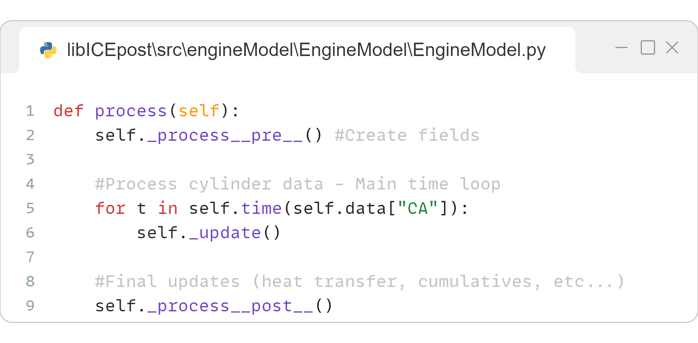
EngineModel class
Base class for modeling ICE, implementing the generic features and coupling all the sub-models
Structure of an object of this class:
Two data-structures which contain the original (raw) and processed (data) data. They are instances of the EngineData class, a wrapper of a pandas.DataFrame
process() – The main method which processes the data and estimates the thermodynamic evolution of the system.
🧱 EngineModel
├─ 🧱 raw
├─ 🧱 data
├─ ...
├─ 🔧 process()
├─ ...
├─ 🔧 integrateVariable(...) ├─ 🔧 IMEP(self)
└─ ...

Slide 31
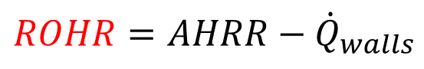
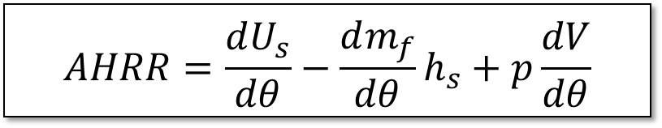
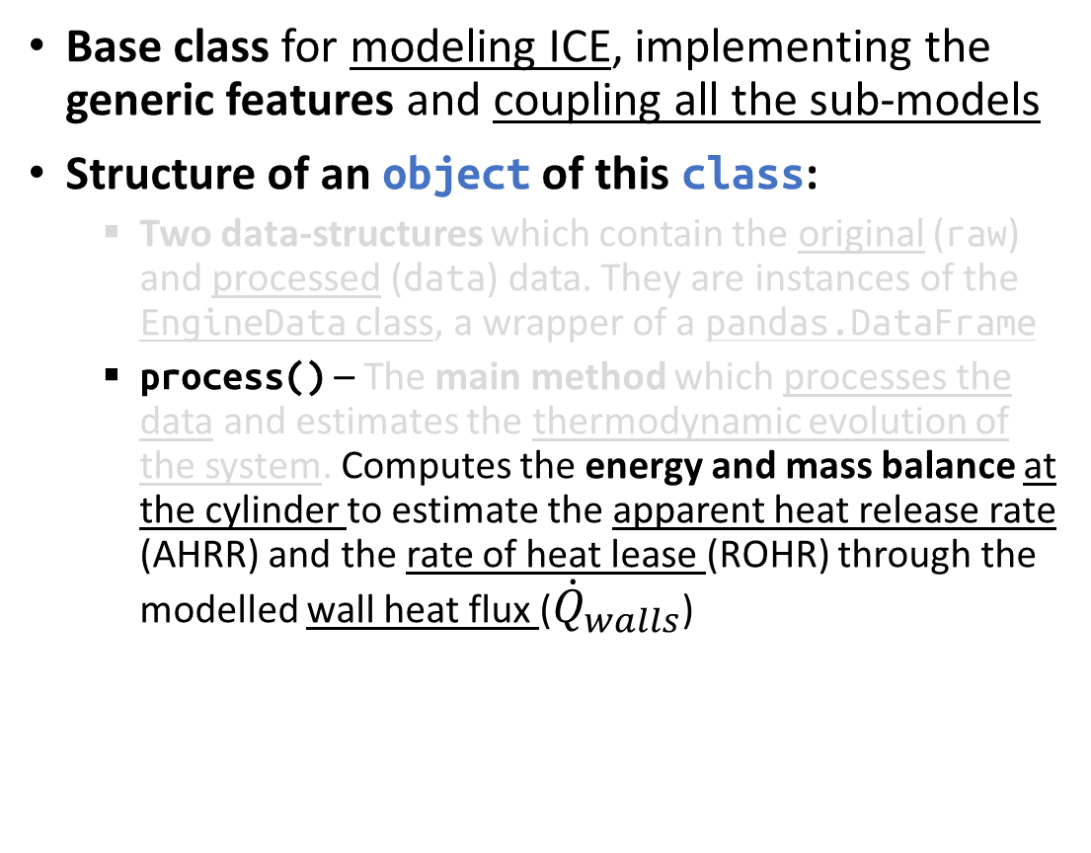
EngineModel class
Base class for modeling ICE, implementing the generic features and coupling all the sub-models
Structure of an object of this class:
Two data-structures which contain the original (raw) and processed (data) data. They are instances of the EngineData class, a wrapper of a pandas.DataFrame
process() – The main method which processes the data and estimates the thermodynamic evolution of the system. Computes the energy and mass balance at the cylinder to estimate the apparent heat release rate (AHRR) and the rate of heat lease (ROHR) through the modelled wall heat flux (${\dot{Q}}_{walls}$)
🧱 EngineModel
├─ 🧱 raw
├─ 🧱 data
├─ ...
├─ 🔧 process()
├─ ...
├─ 🔧 integrateVariable(...) ├─ 🔧 IMEP(self)
└─ ...
$$AHRR=\frac{dU_{s}}{dθ}−\frac{dm_{f}}{dθ}h_{s}+p\frac{dV}{dθ}$$
Energy balance
$$ROHR=AHRR−{\dot{Q}}_{walls}$$

Slide 32
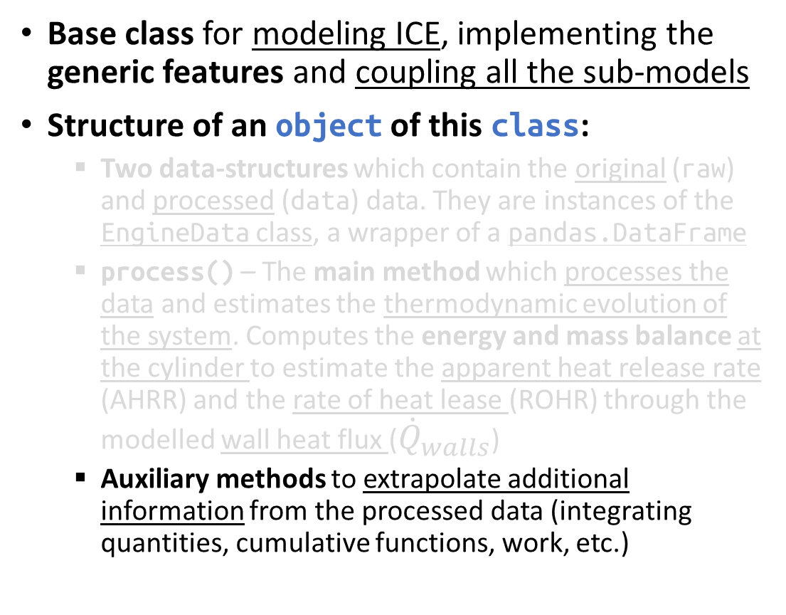
EngineModel class
Base class for modeling ICE, implementing the generic features and coupling all the sub-models
Structure of an object of this class:
Two data-structures which contain the original (raw) and processed (data) data. They are instances of the EngineData class, a wrapper of a pandas.DataFrame
process() – The main method which processes the data and estimates the thermodynamic evolution of the system. Computes the energy and mass balance at the cylinder to estimate the apparent heat release rate (AHRR) and the rate of heat lease (ROHR) through the modelled wall heat flux (${\dot{Q}}_{walls}$)
Auxiliary methods to extrapolate additional information from the processed data (integrating quantities, cumulative functions, work, etc.)
🧱 EngineModel
├─ 🧱 raw
├─ 🧱 data
├─ ...
├─ 🔧 process()
├─ ...
├─ 🔧 integrateVariable(...) ├─ 🔧 IMEP(self)
└─ ...

Slide 33
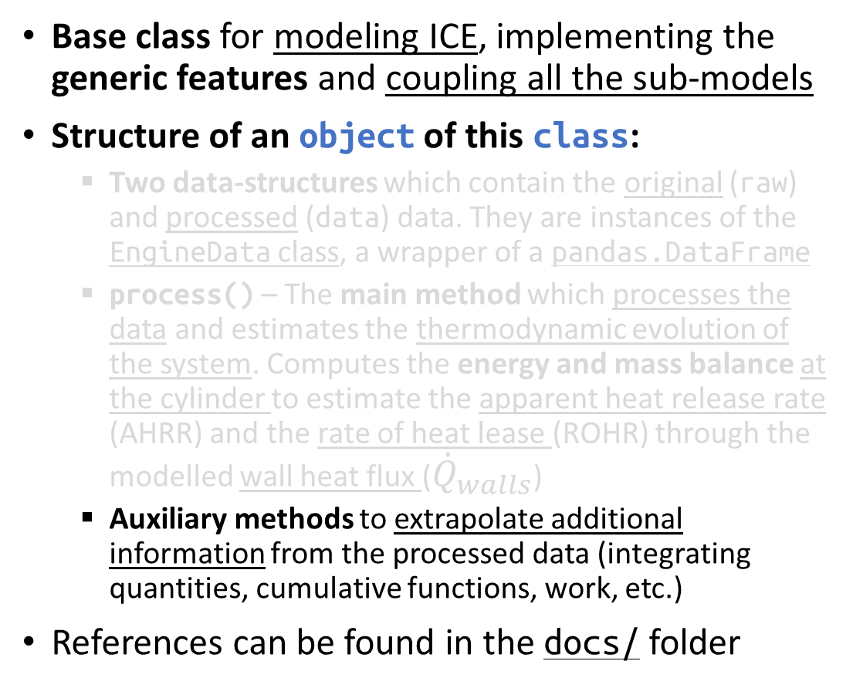
EngineModel class
Base class for modeling ICE, implementing the generic features and coupling all the sub-models
Structure of an object of this class:
Two data-structures which contain the original (raw) and processed (data) data. They are instances of the EngineData class, a wrapper of a pandas.DataFrame
process() – The main method which processes the data and estimates the thermodynamic evolution of the system. Computes the energy and mass balance at the cylinder to estimate the apparent heat release rate (AHRR) and the rate of heat lease (ROHR) through the modelled wall heat flux (${\dot{Q}}_{walls}$)
Auxiliary methods to extrapolate additional information from the processed data (integrating quantities, cumulative functions, work, etc.)
References can be found in the docs/ folder
🧱 EngineModel
├─ 🧱 raw
├─ 🧱 data
├─ ...
├─ 🔧 process()
├─ ...
├─ 🔧 integrateVariable(...) ├─ 🔧 IMEP(self)
└─ ...

Slide 34
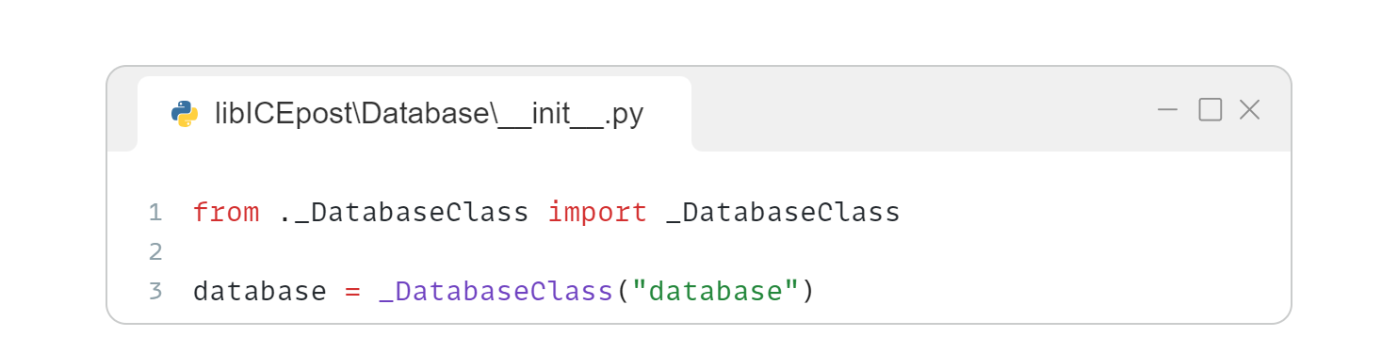
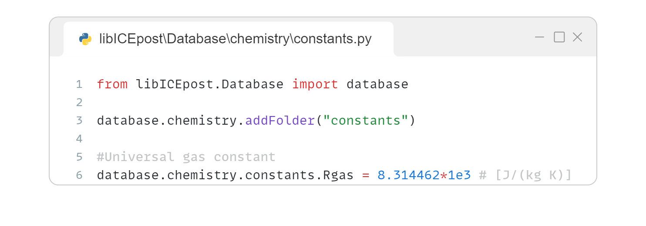
libICEpost.Database
A built-in database with useful data (periodic table, molecules, fuels, thermophysical properties, etc.)
Contains the variable database: a container with a folder-like structure, which is dynamically populated loading the library sub-packages
It accepts both dot (.) and key ([str]) access
📦 libICEpost
├─ 📁 src
│ ├─ 📁 base
│ ├─ 📁 thermophysicalModels
│ ├─ 📁 engineModel
│ ├─ ...
│ └─ 📁 __init__.py
├─ 📁 scripts
├─ 📁 Database
│ ├─ 📁 chemistry
│ ├─ 📁 data
│ ├─ 📁 ...
│ └─ 📁 __init__.py
└─ 📁 __init__.py
Master folder “database”
Adding named branches (_DatabaseClass instances)
Populating the folders

Slide 35
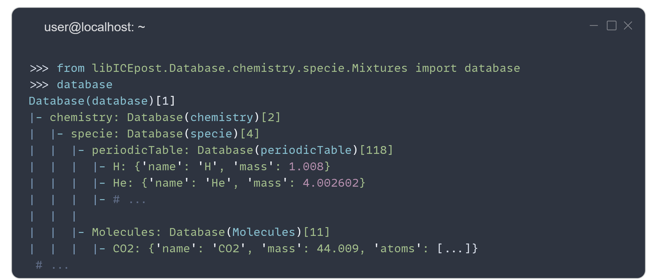
libICEpost.Database
A built-in database with useful data (periodic table, molecules, fuels, thermophysical properties, etc.)
Contains the variable database: a container with a folder-like structure, which is dynamically populated loading the library sub-packages
It accepts both dot (.) and key ([str]) access
📦 libICEpost
├─ 📁 src
│ ├─ 📁 base
│ ├─ 📁 thermophysicalModels
│ ├─ 📁 engineModel
│ ├─ ...
│ └─ 📁 __init__.py
├─ 📁 scripts
├─ 📁 Database
│ ├─ 📁 chemistry
│ ├─ 📁 data
│ ├─ 📁 ...
│ └─ 📁 __init__.py
└─ 📁 __init__.py
Loading mixtures in the database
Importing the database object

Slide 36
libICEpost.Database
A built-in database with useful data (periodic table, molecules, fuels, thermophysical properties, etc.)
Contains the variable database: a container with a folder-like structure, which is dynamically populated loading the library sub-packages
It accepts both dot (.) and key ([str]) access
📦 libICEpost
├─ 📁 src
│ ├─ 📁 base
│ ├─ 📁 thermophysicalModels
│ ├─ 📁 engineModel
│ ├─ ...
│ └─ 📁 __init__.py
├─ 📁 scripts
├─ 📁 Database
│ ├─ 📁 chemistry
│ ├─ 📁 data
│ ├─ 📁 ...
│ └─ 📁 __init__.py
└─ 📁 __init__.py
Name of the folder
Number of elements in the folder
Name of the entry (key)

Slide 37
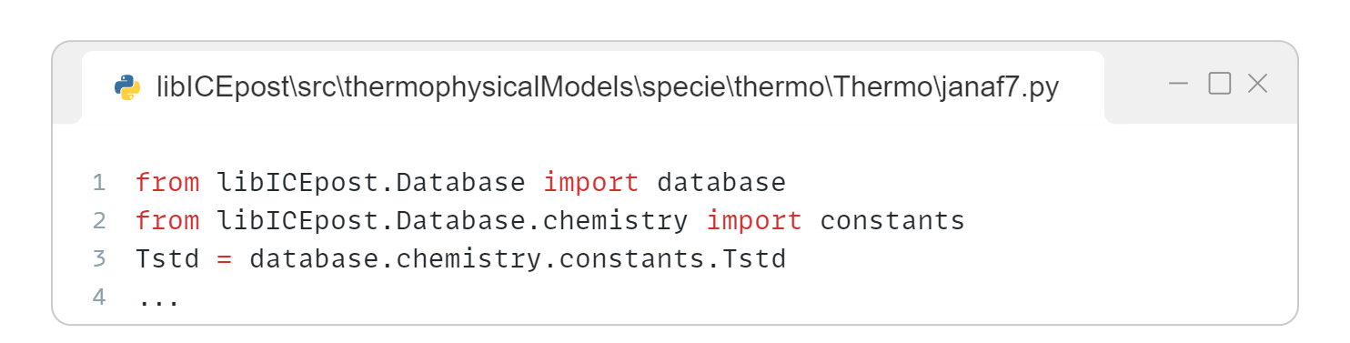
libICEpost.Database
A built-in database with useful data (periodic table, molecules, fuels, thermophysical properties, etc.)
Contains the variable database: a container with a folder-like structure, which is dynamically populated loading the library sub-packages
It accepts both dot (.) and key ([str]) access
📦 libICEpost
├─ 📁 src
│ ├─ 📁 base
│ ├─ 📁 thermophysicalModels
│ ├─ 📁 engineModel
│ ├─ ...
│ └─ 📁 __init__.py
├─ 📁 scripts
├─ 📁 Database
│ ├─ 📁 chemistry
│ ├─ 📁 data
│ ├─ 📁 ...
│ └─ 📁 __init__.py
└─ 📁 __init__.py
Loading the database instance
Loading the sub-pachage, which populates database.chemistry.constants
Accessing the variable

Slide 38
Example – CFD simulation of spark-ignition engine
Tutorial case: post-process the results of a CFD simulation of a spark-ignition engine to extrapolate the rate of heat release profile.
The tutorial can be found in the GitHub repository at tutorials/sparkIgnition/
📁 tutorials/sparkIgnition
├─ 📁 data
│ ├─ 📄 p.Cyl
│ ├─ 📄 massBal.cyl
│ └─ 📄 uprime.cyl
├─ 📁 dictionaries
│ ├─ 📄 controlDict.py
│ ├─ 📄 thermophysicalProperties.py
│ ├─ 📄 combustionProperties.py
│ └─ 📄 dataDict.py
└─ 📁 main.py

Slide 39
Setup files
Tutorial case: post-process the results of a CFD simulation of a spark-ignition engine to extrapolate the rate of heat release profile.
The tutorial can be found in the GitHub repository at tutorials/sparkIgnition/
Content of the tutorial:
main.py – The python script to be executed
📁 tutorials/sparkIgnition
├─ 📁 data
│ ├─ 📄 p.Cyl
│ ├─ 📄 massBal.cyl
│ └─ 📄 uprime.cyl
├─ 📁 dictionaries
│ ├─ 📄 controlDict.py
│ ├─ 📄 thermophysicalProperties.py
│ ├─ 📄 combustionProperties.py
│ └─ 📄 dataDict.py
└─ 📁 main.py

Slide 40
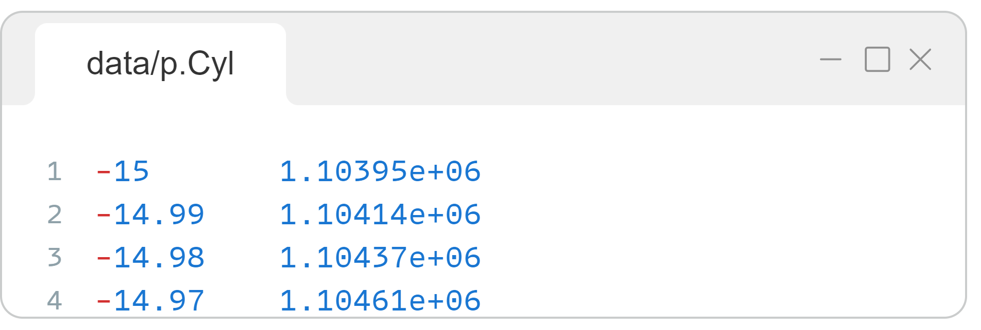
Setup files
Tutorial case: post-process the results of a CFD simulation of a spark-ignition engine to extrapolate the rate of heat release profile.
The tutorial can be found in the GitHub repository at tutorials/sparkIgnition/
Content of the tutorial:
main.py – The python script to be executed
data – Contains results of the CFD simulations, i.e., in-cylinder traces of integral or average quantities
📁 tutorials/sparkIgnition
├─ 📁 data
│ ├─ 📄 p.Cyl
│ ├─ 📄 massBal.cyl
│ └─ 📄 uprime.cyl
├─ 📁 dictionaries
│ ├─ 📄 controlDict.py
│ ├─ 📄 thermophysicalProperties.py
│ ├─ 📄 combustionProperties.py
│ └─ 📄 dataDict.py
└─ 📁 main.py
Mean pressure
Total mass
Mean turbulent velocity fluctuation
Time in crank angle degrees [CAD]
Instantaneous mean pressure [Pa]

Slide 41
Setup files
Tutorial case: post-process the results of a CFD simulation of a spark-ignition engine to extrapolate the rate of heat release profile.
The tutorial can be found in the GitHub repository at tutorials/sparkIgnition/
Content of the tutorial:
main.py – The python script to be executed
data – Contains results of the CFD simulations, i.e., in-cylinder traces of integral or average quantities
dictionaries – Contains all the dictionaries that are used to construct the engine model
📁 tutorials/sparkIgnition
├─ 📁 data
│ ├─ 📄 p.Cyl
│ ├─ 📄 massBal.cyl
│ └─ 📄 uprime.cyl
├─ 📁 dictionaries
│ ├─ 📄 controlDict.py
│ ├─ 📄 thermophysicalProperties.py
│ ├─ 📄 combustionProperties.py
│ └─ 📄 dataDict.py
└─ 📁 main.py

Slide 42
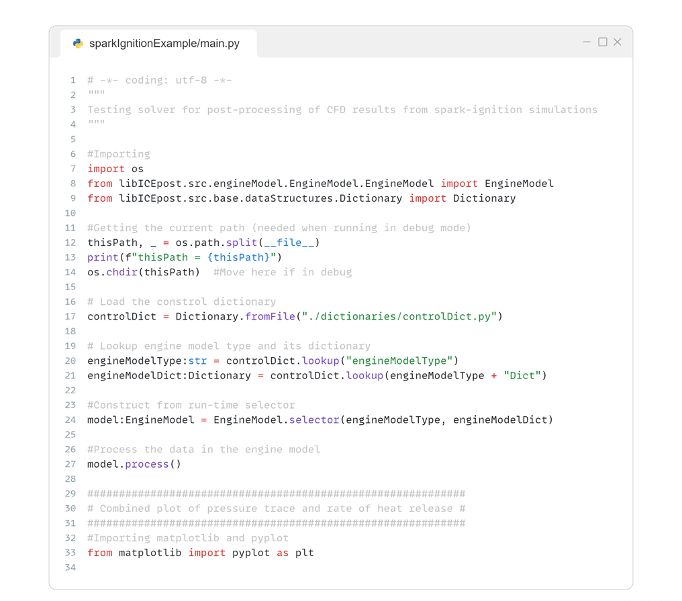
Setup files – main.py
Importing EngineModel and Dictionary from libICEpost

Slide 43
Setup files – main.py
Importing the configuration of the engine model from controlDictionary.py file into a Dictionary entry with the fromFile classmethod

Slide 44
Setup files – main.py
Lookup the EngineModel to use and its construction dictionary and then construct it through the selector classmethod

Slide 45
Setup files – main.py
Process the data loaded in the engine model

Slide 46
Setup files – main.py
Plotting results

Slide 47
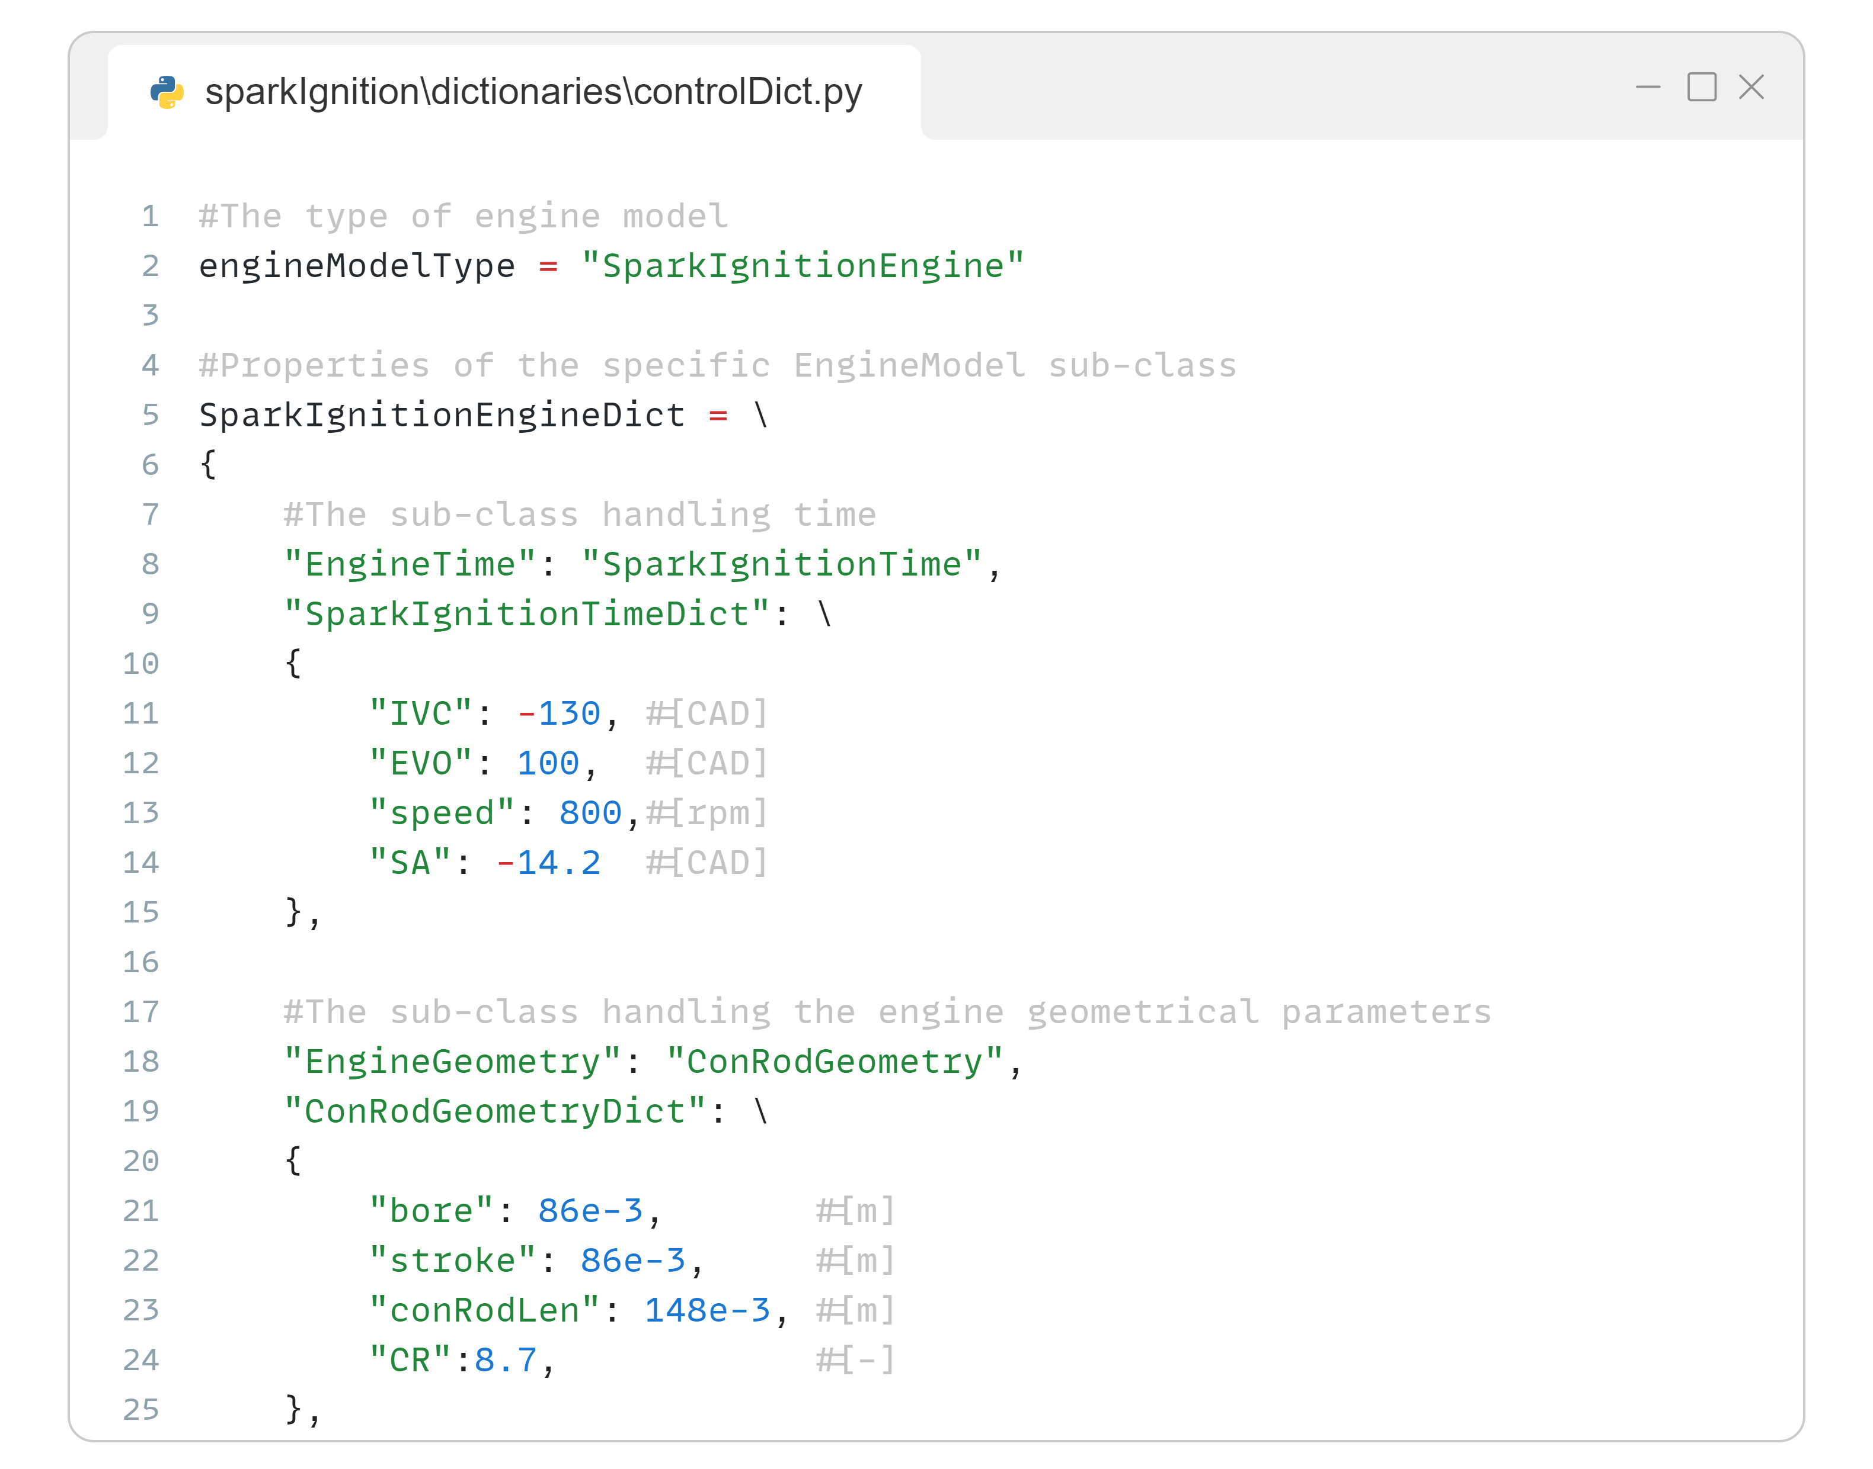
Setup files – controlDict.py
This control dictionary contains the specific engine model to use and the construction dictionary of the corresponding class.

Slide 48
Setup files – controlDict.py
This control dictionary contains the specific engine model to use and the construction dictionary of the corresponding class.
The construction dictionary must contain:
TypeName and construction dictionary (in the form <TypeName>Dict) for EngineTime and EngineGeometry sub-models

Slide 49
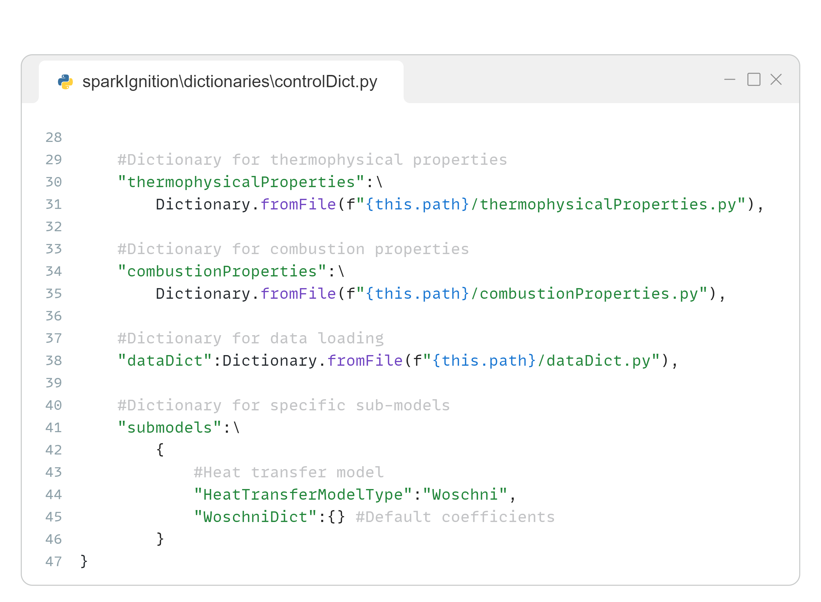
Setup files – controlDict.py
This control dictionary contains the specific engine model to use and the construction dictionary of the corresponding class.
The construction dictionary must contain:
TypeName and construction dictionary (in the form <TypeName>Dict) for EngineTime and EngineGeometry sub-models
Two dictionaries containing the thermophysical and combustion properties of mixtures

Slide 50
Setup files – controlDict.py
This control dictionary contains the specific engine model to use and the construction dictionary of the corresponding class.
The construction dictionary must contain:
TypeName and construction dictionary (in the form <TypeName>Dict) for EngineTime and EngineGeometry sub-models
Two dictionaries containing the thermophysical and combustion properties of mixtures
A dictionary containing the information for loading input data and pre-processing (filtering, scaling, etc.)

Slide 51
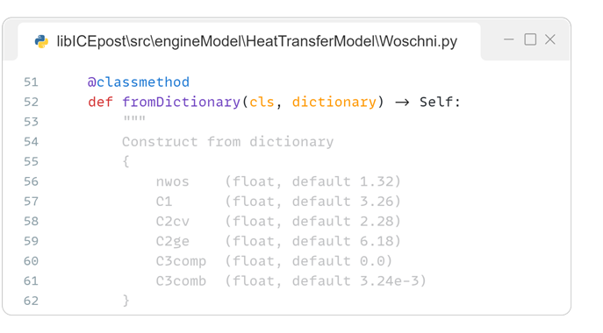
Setup files – controlDict.py
This control dictionary contains the specific engine model to use and the construction dictionary of the corresponding class.
The construction dictionary must contain:
TypeName and construction dictionary (in the form <TypeName>Dict) for EngineTime and EngineGeometry sub-models
Two dictionaries containing the thermophysical and combustion properties of mixtures
A dictionary containing the information for loading input data and pre-processing (filtering, scaling, etc.)
A dictionary containing the specific information of other sub-models (e.g. heat transfer)

Slide 52
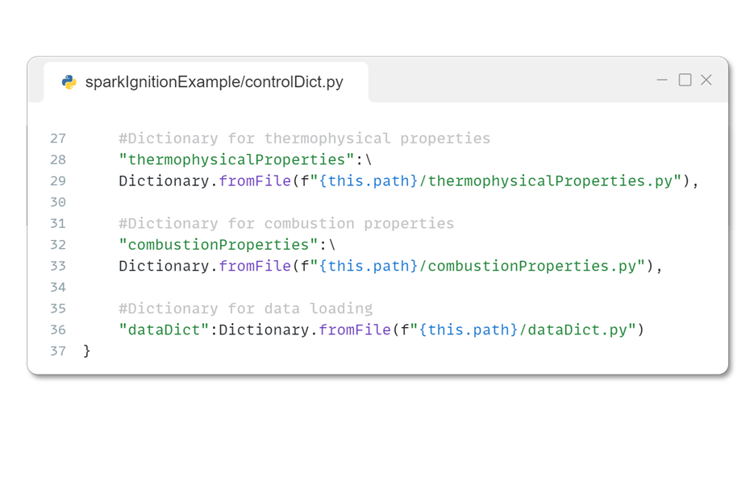
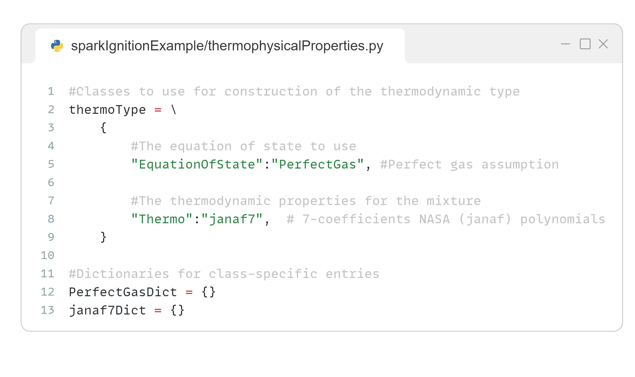
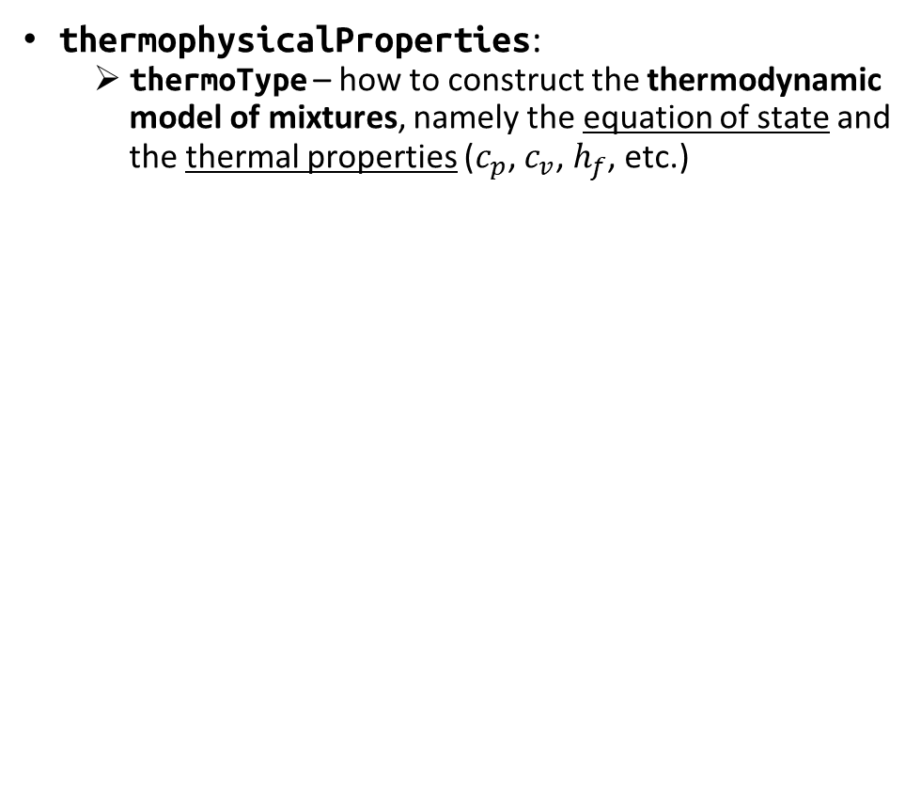
Setup files – thermophysicalProperties
thermophysicalProperties:
thermoType – how to construct the thermodynamic model of mixtures, namely the equation of state and the thermal properties ($c_{p}$, $c_{v}$, $h_{f}$, etc.)

Slide 53
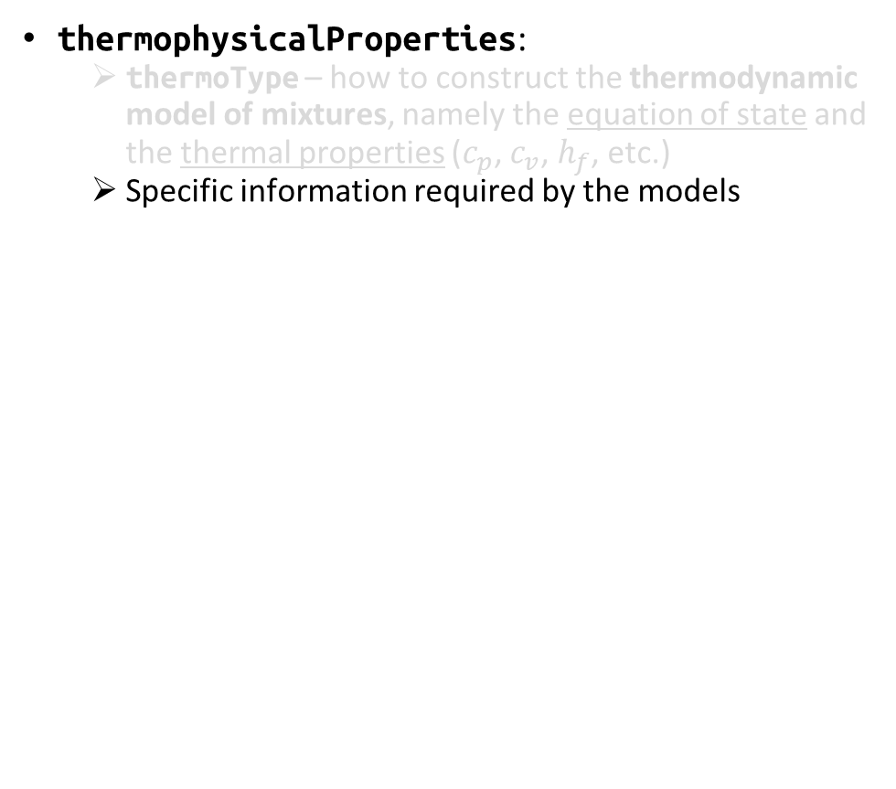
Setup files – thermophysicalProperties
thermophysicalProperties:
thermoType – how to construct the thermodynamic model of mixtures, namely the equation of state and the thermal properties ($c_{p}$, $c_{v}$, $h_{f}$, etc.)
Specific information required by the models

Slide 54
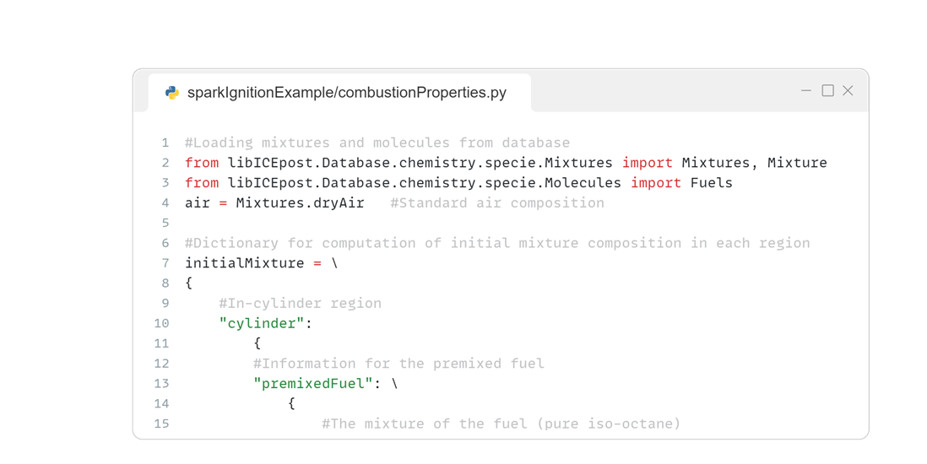
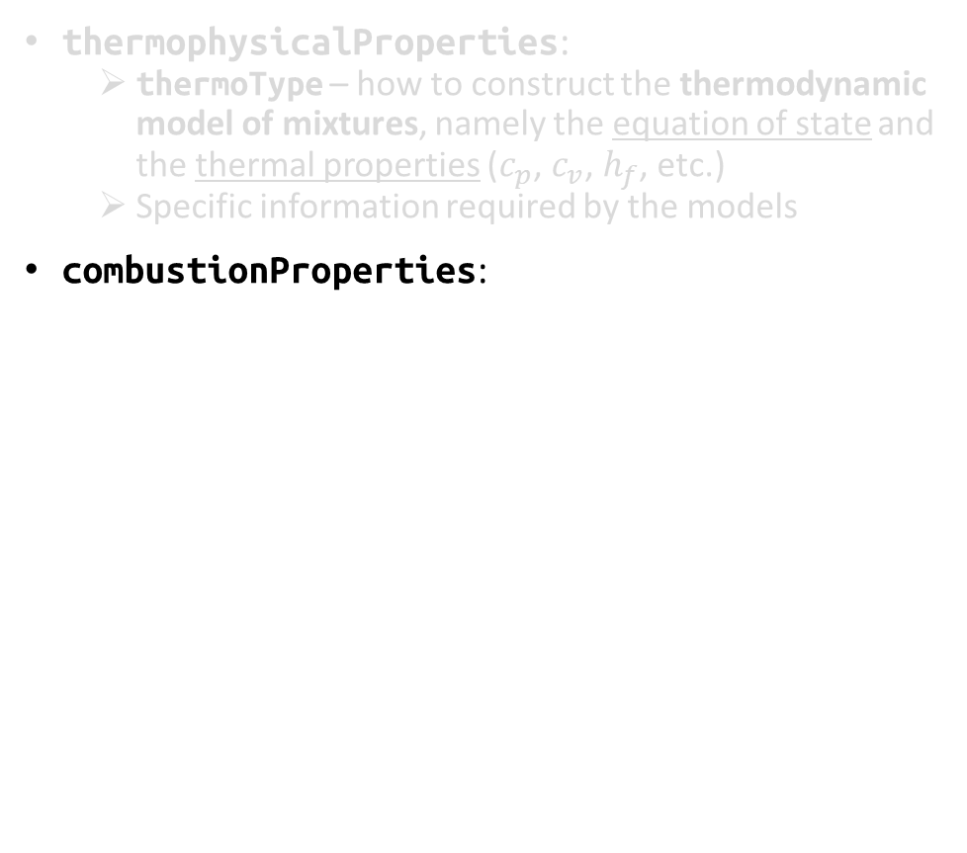
Setup files – combustionProperties
thermophysicalProperties:
thermoType – how to construct the thermodynamic model of mixtures, namely the equation of state and the thermal properties ($c_{p}$, $c_{v}$, $h_{f}$, etc.)
Specific information required by the models
combustionProperties:
Loading properties from database

Slide 55
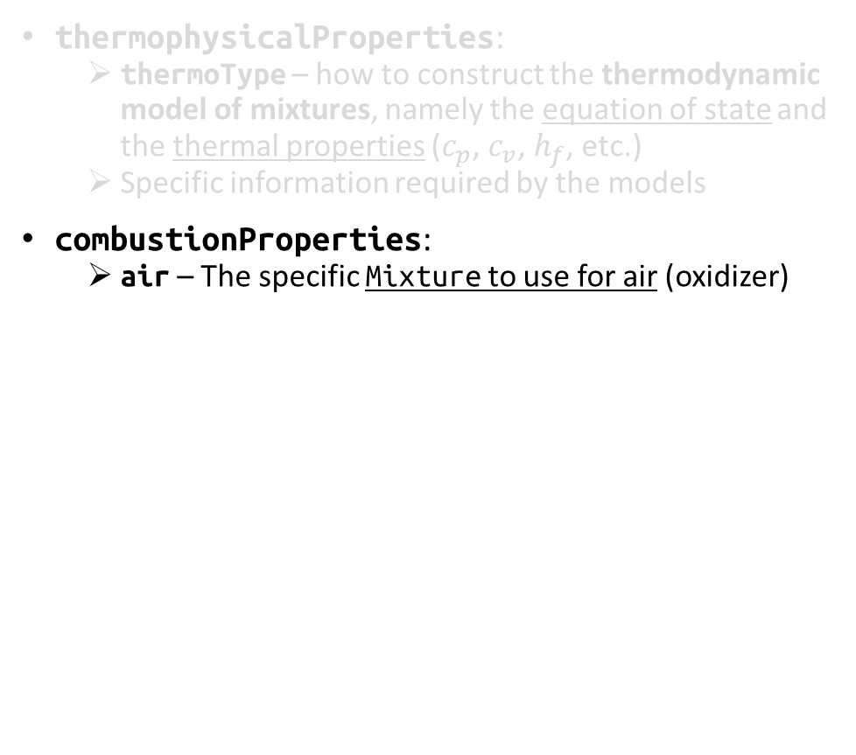
Setup files – combustionProperties
thermophysicalProperties:
thermoType – how to construct the thermodynamic model of mixtures, namely the equation of state and the thermal properties ($c_{p}$, $c_{v}$, $h_{f}$, etc.)
Specific information required by the models
combustionProperties:
air – The specific Mixture to use for air (oxidizer)
Using the entry from database

Slide 56
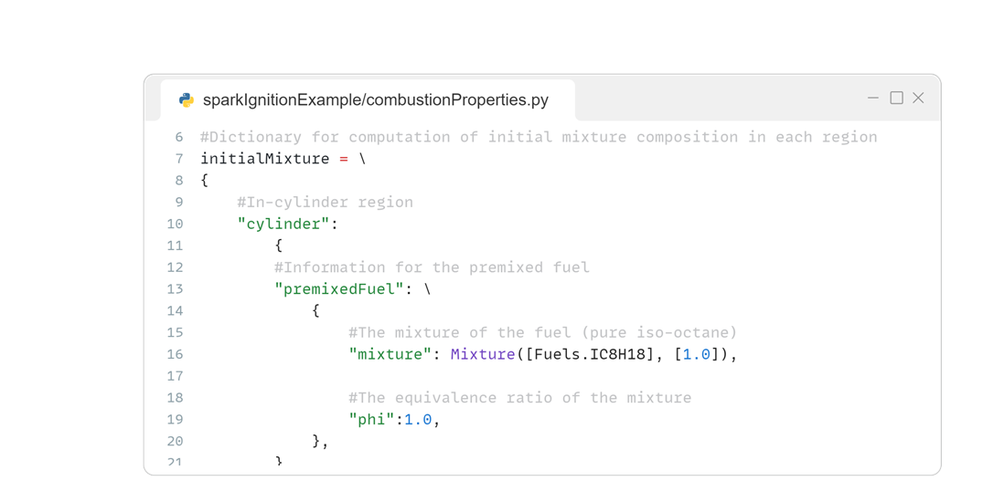
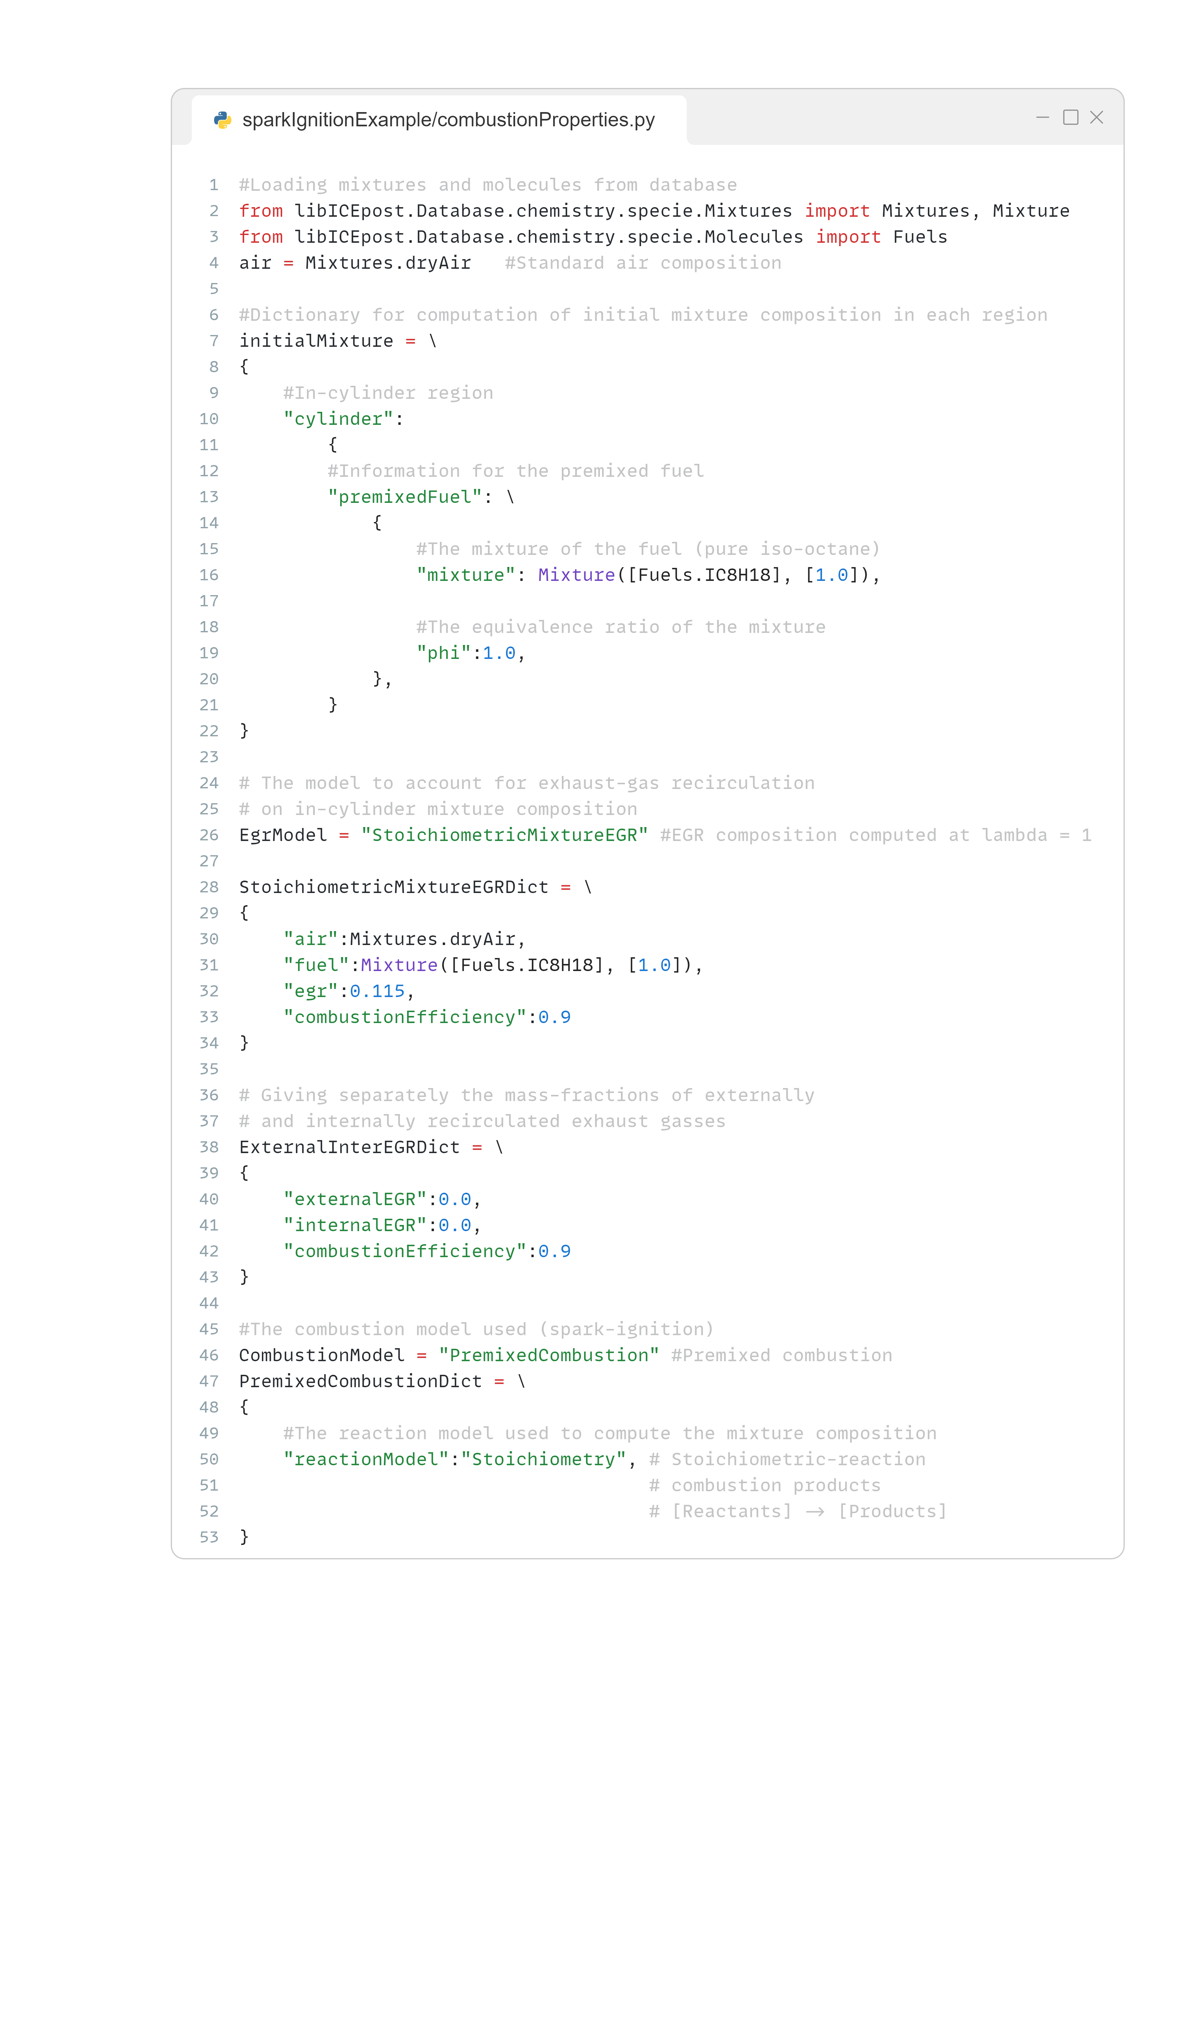
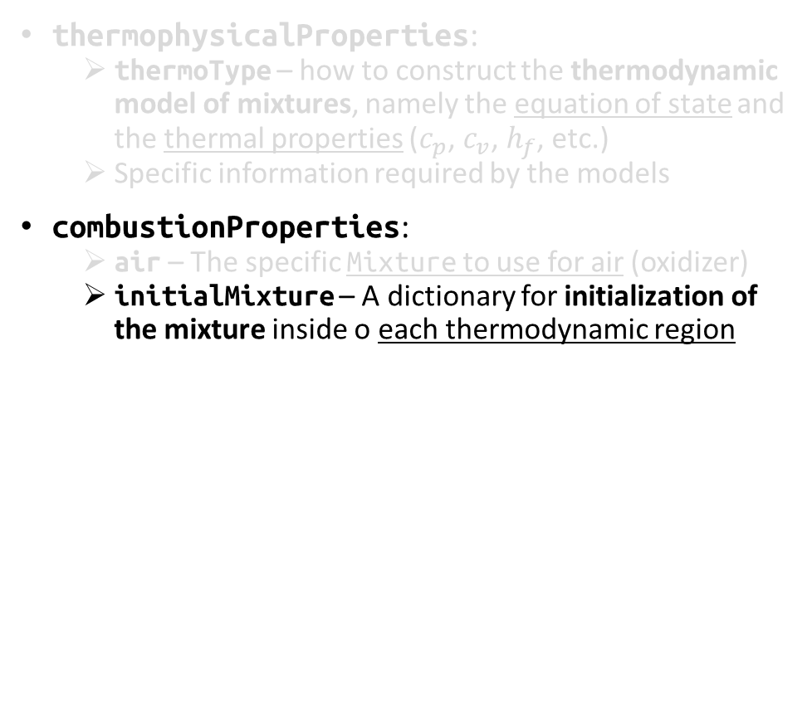
Setup files – combustionProperties
thermophysicalProperties:
thermoType – how to construct the thermodynamic model of mixtures, namely the equation of state and the thermal properties ($c_{p}$, $c_{v}$, $h_{f}$, etc.)
Specific information required by the models
combustionProperties:
air – The specific Mixture to use for air (oxidizer)
initialMixture – A dictionary for initialization of the mixture inside o each thermodynamic region
Using the entry from database

Slide 57
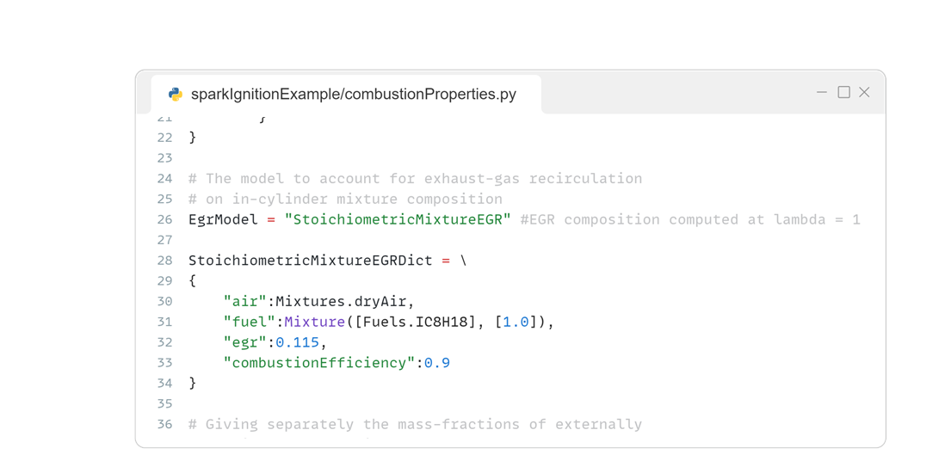
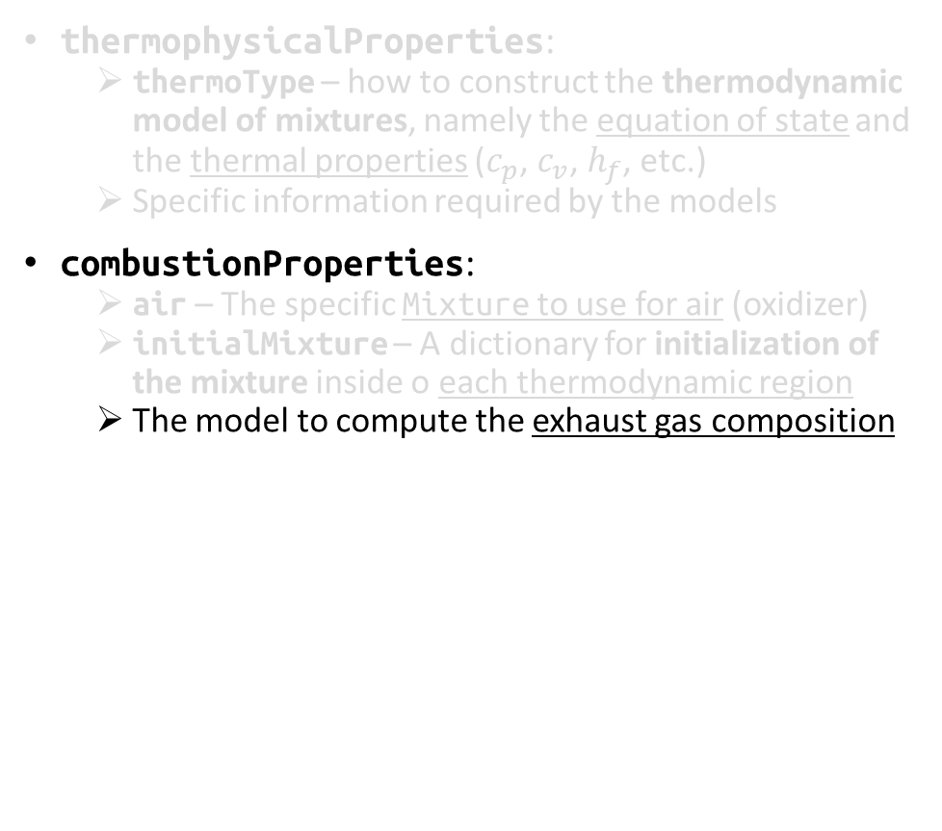
Setup files – combustionProperties
thermophysicalProperties:
thermoType – how to construct the thermodynamic model of mixtures, namely the equation of state and the thermal properties ($c_{p}$, $c_{v}$, $h_{f}$, etc.)
Specific information required by the models
combustionProperties:
air – The specific Mixture to use for air (oxidizer)
initialMixture – A dictionary for initialization of the mixture inside o each thermodynamic region
The model to compute the exhaust gas composition

Slide 58
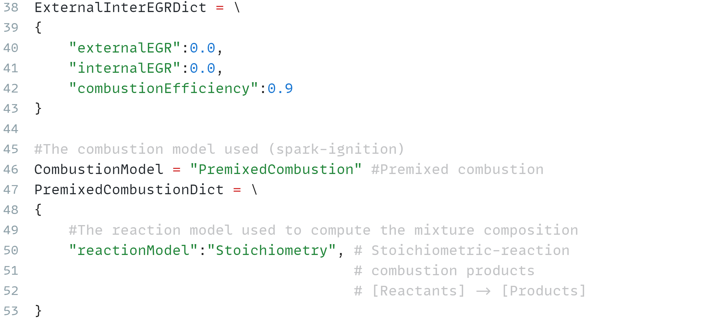
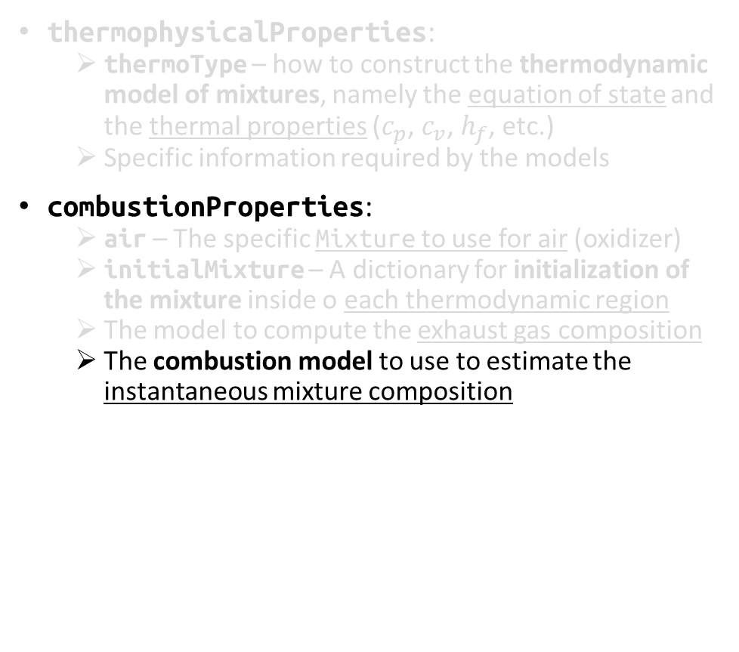
Setup files – combustionProperties
thermophysicalProperties:
thermoType – how to construct the thermodynamic model of mixtures, namely the equation of state and the thermal properties ($c_{p}$, $c_{v}$, $h_{f}$, etc.)
Specific information required by the models
combustionProperties:
air – The specific Mixture to use for air (oxidizer)
initialMixture – A dictionary for initialization of the mixture inside o each thermodynamic region
The model to compute the exhaust gas composition
The combustion model to use to estimate the instantaneous mixture composition

Slide 59
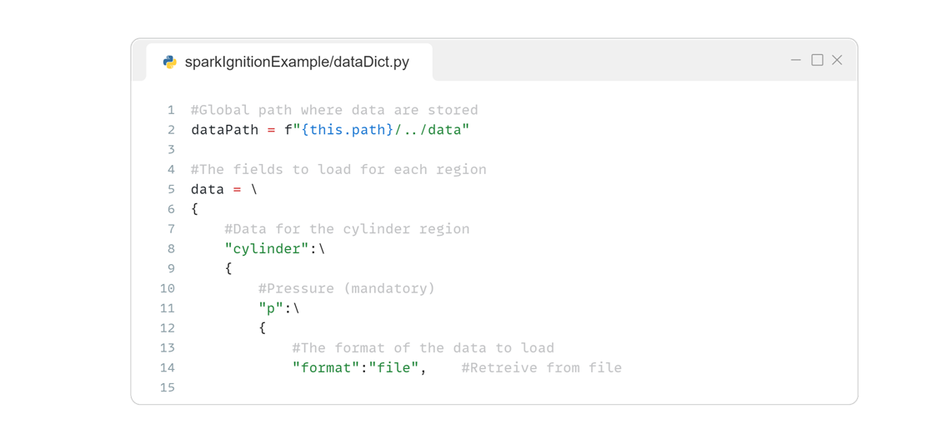
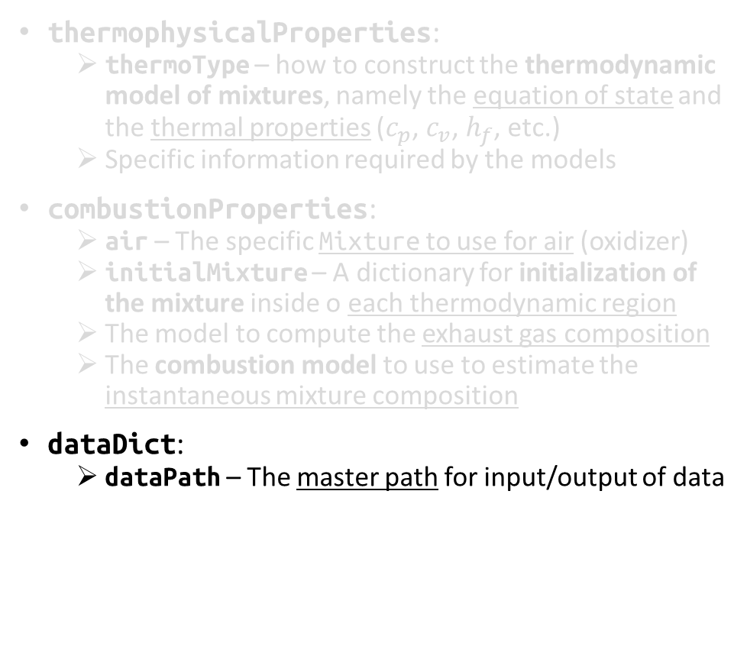
Setup files – dataDict
thermophysicalProperties:
thermoType – how to construct the thermodynamic model of mixtures, namely the equation of state and the thermal properties ($c_{p}$, $c_{v}$, $h_{f}$, etc.)
Specific information required by the models
combustionProperties:
air – The specific Mixture to use for air (oxidizer)
initialMixture – A dictionary for initialization of the mixture inside o each thermodynamic region
The model to compute the exhaust gas composition
The combustion model to use to estimate the instantaneous mixture composition
dataDict:
dataPath – The master path for input/output of data

Slide 60

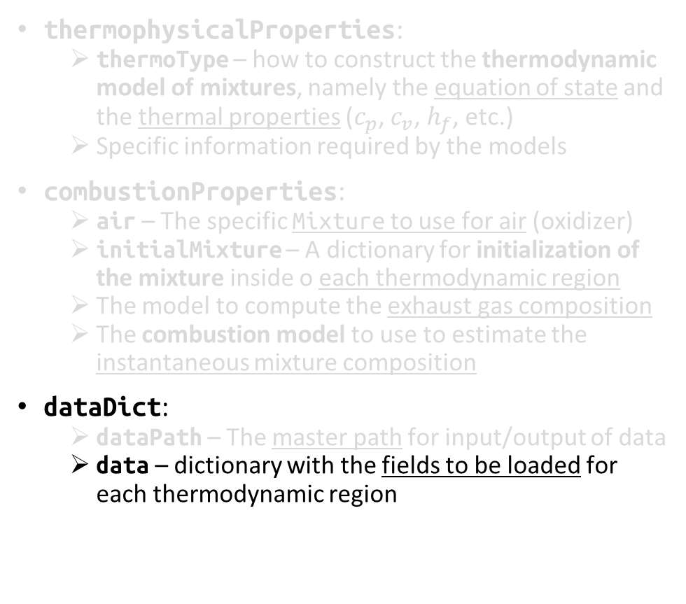
Setup files – dataDict
thermophysicalProperties:
thermoType – how to construct the thermodynamic model of mixtures, namely the equation of state and the thermal properties ($c_{p}$, $c_{v}$, $h_{f}$, etc.)
Specific information required by the models
combustionProperties:
air – The specific Mixture to use for air (oxidizer)
initialMixture – A dictionary for initialization of the mixture inside o each thermodynamic region
The model to compute the exhaust gas composition
The combustion model to use to estimate the instantaneous mixture composition
dataDict:
dataPath – The master path for input/output of data
data – dictionary with the fields to be loaded for each thermodynamic region
Region name
Field name

Slide 61
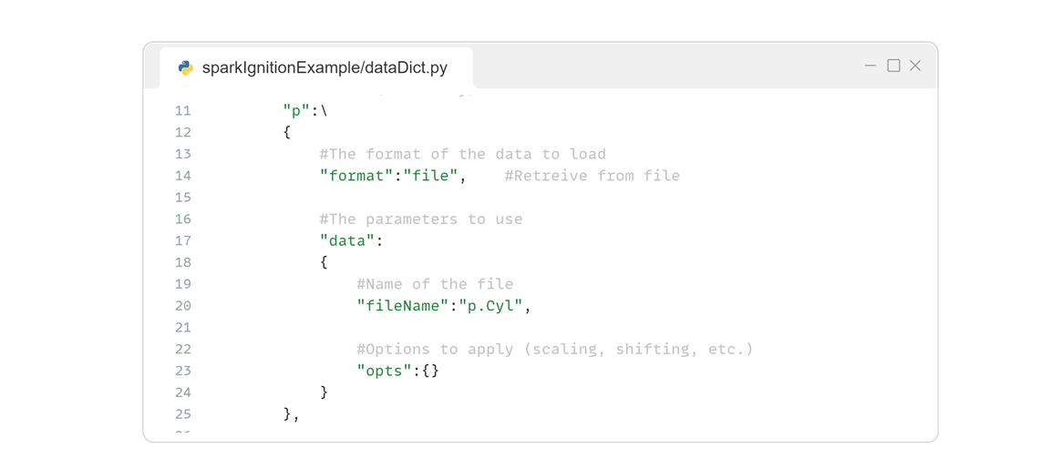
Setup files – dataDict
thermophysicalProperties:
thermoType – how to construct the thermodynamic model of mixtures, namely the equation of state and the thermal properties ($c_{p}$, $c_{v}$, $h_{f}$, etc.)
Specific information required by the models
combustionProperties:
air – The specific Mixture to use for air (oxidizer)
initialMixture – A dictionary for initialization of the mixture inside o each thermodynamic region
The model to compute the exhaust gas composition
The combustion model to use to estimate the instantaneous mixture composition
dataDict:
dataPath – The master path for input/output of data
data – dictionary with the fields to be loaded for each thermodynamic region
Format for loading the variable. Multiple formats available (see example file for more)
File name (relative to dataPath)

Slide 62
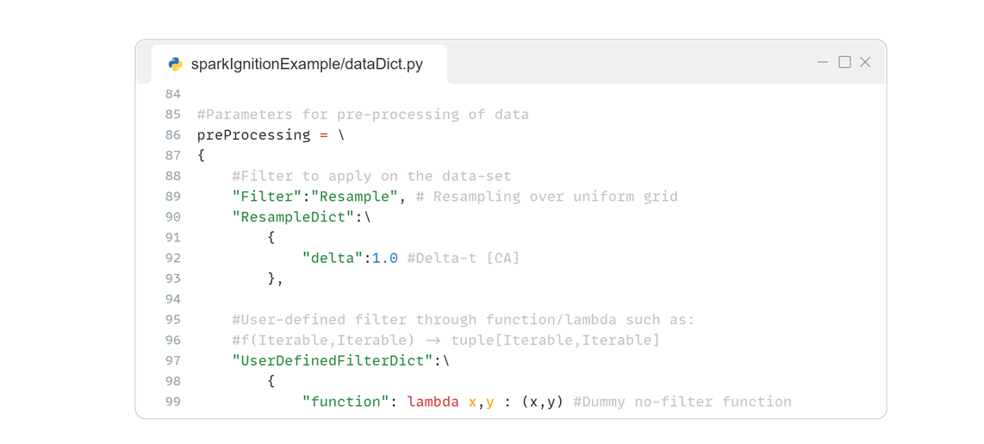
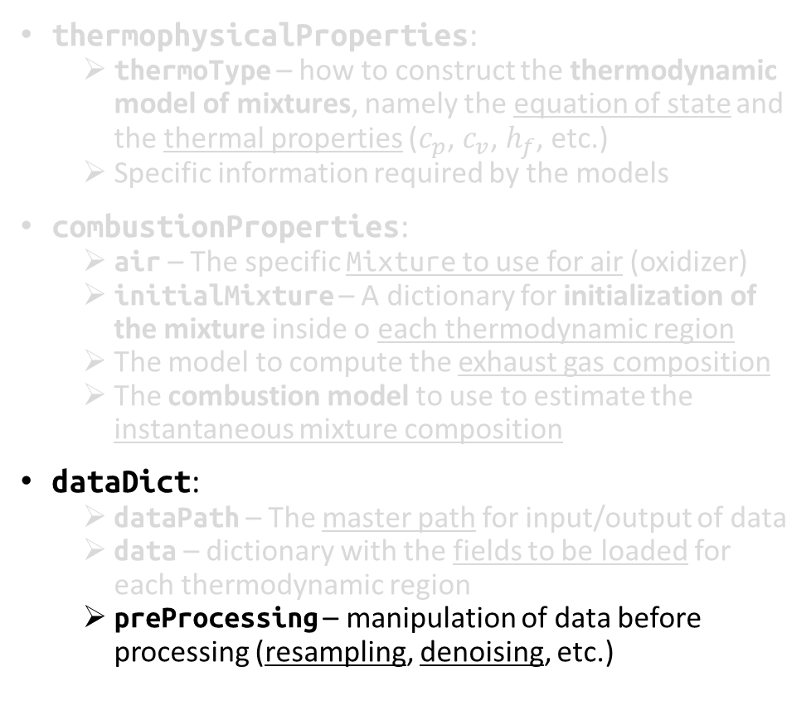
Setup files – dataDict
thermophysicalProperties:
thermoType – how to construct the thermodynamic model of mixtures, namely the equation of state and the thermal properties ($c_{p}$, $c_{v}$, $h_{f}$, etc.)
Specific information required by the models
combustionProperties:
air – The specific Mixture to use for air (oxidizer)
initialMixture – A dictionary for initialization of the mixture inside o each thermodynamic region
The model to compute the exhaust gas composition
The combustion model to use to estimate the instantaneous mixture composition
dataDict:
dataPath – The master path for input/output of data
data – dictionary with the fields to be loaded for each thermodynamic region
preProcessing – manipulation of data before processing (resampling, denoising, etc.)

Slide 63
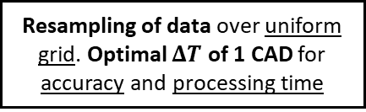
Setup files – dataDict
thermophysicalProperties:
thermoType – how to construct the thermodynamic model of mixtures, namely the equation of state and the thermal properties ($c_{p}$, $c_{v}$, $h_{f}$, etc.)
Specific information required by the models
combustionProperties:
air – The specific Mixture to use for air (oxidizer)
initialMixture – A dictionary for initialization of the mixture inside o each thermodynamic region
The model to compute the exhaust gas composition
The combustion model to use to estimate the instantaneous mixture composition
dataDict:
dataPath – The master path for input/output of data
data – dictionary with the fields to be loaded for each thermodynamic region
preProcessing – manipulation of data before processing (resampling, denoising, etc.)
Resampling of data over uniform grid. Optimal $ΔT$ of 1 CAD for accuracy and processing time

Slide 64
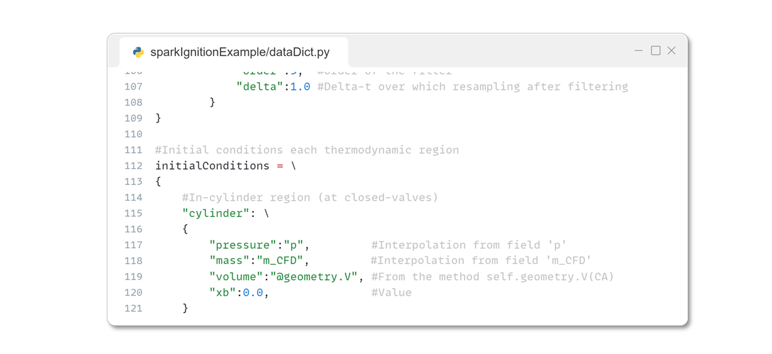
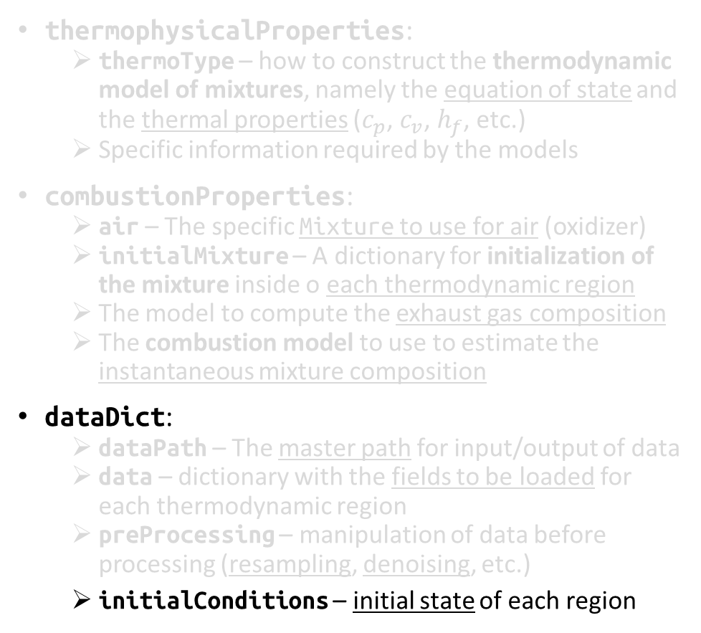
Setup files – dataDict
thermophysicalProperties:
thermoType – how to construct the thermodynamic model of mixtures, namely the equation of state and the thermal properties ($c_{p}$, $c_{v}$, $h_{f}$, etc.)
Specific information required by the models
combustionProperties:
air – The specific Mixture to use for air (oxidizer)
initialMixture – A dictionary for initialization of the mixture inside o each thermodynamic region
The model to compute the exhaust gas composition
The combustion model to use to estimate the instantaneous mixture composition
dataDict:
dataPath – The master path for input/output of data
data – dictionary with the fields to be loaded for each thermodynamic region
preProcessing – manipulation of data before processing (resampling, denoising, etc.)
initialConditions – initial state of each region

Slide 65
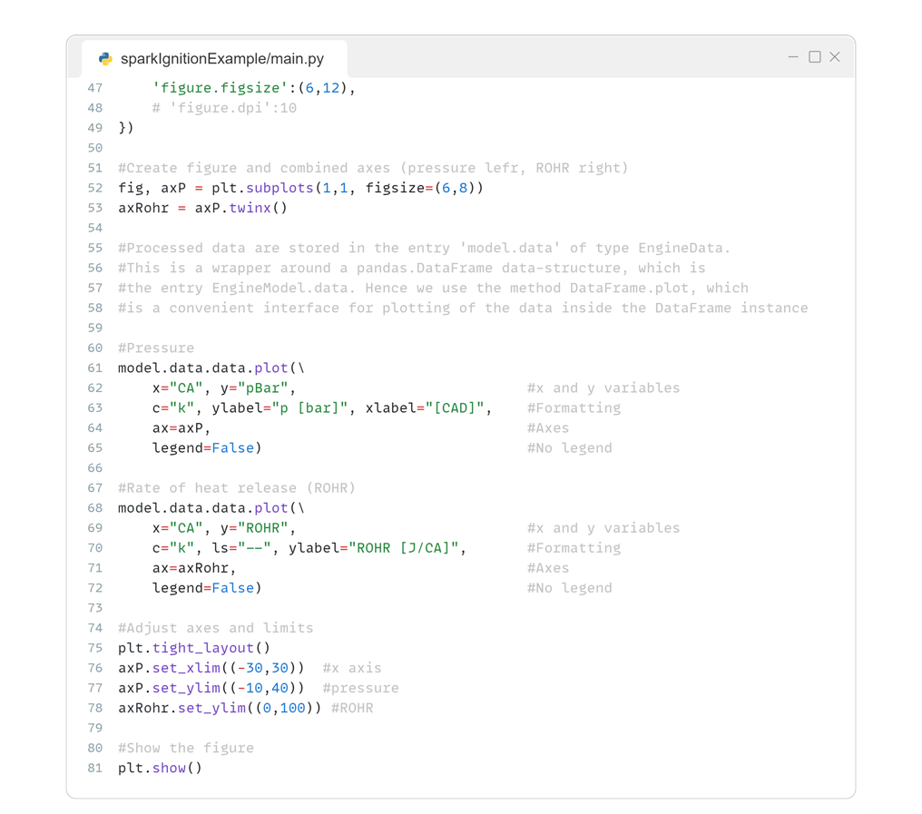
Plotting results
Generating the figure and axes: left axis for pressure trace and right for ROHR

Slide 66
Plotting results
Accessing the results at model.data, which is a EngineData instance. Then accessing the data entry, which is of type pandas.DataFrame, which has the convenient method plot for visualizing the stored data

Slide 67
Plotting results
Pressure trace on left axis
ROHR on right axis

Slide 68
Plotting results
Adjusting the axes and limits

Slide 69
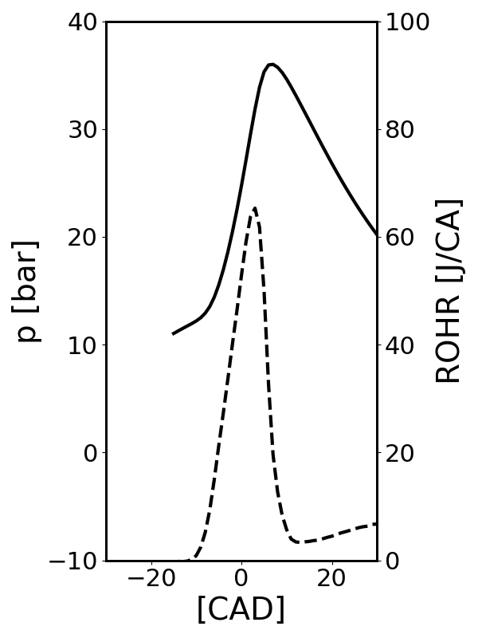
Plotting results
Showing the plot

Slide 70
Final remarks
Next steps:
Extension of the classes to handle different engine configurations (Diesel engines, Wankel, etc…)
Implementation of existing workflows into executable scripts
Development of a GUI to simplify user experience

Slide 71
Contact information
Federico Ramognino
Department of Energy, Politecnico di Milano
Via Lambruschini, 4
20156 Milano, Italy
federico.ramognino@polimi.it
PyPI: https://pypi.org/project/libICEpost/
GitHub: https://github.com/RamogninoF/LibICE-post

